Slide 1
Getting regional leadership right

Slide 2
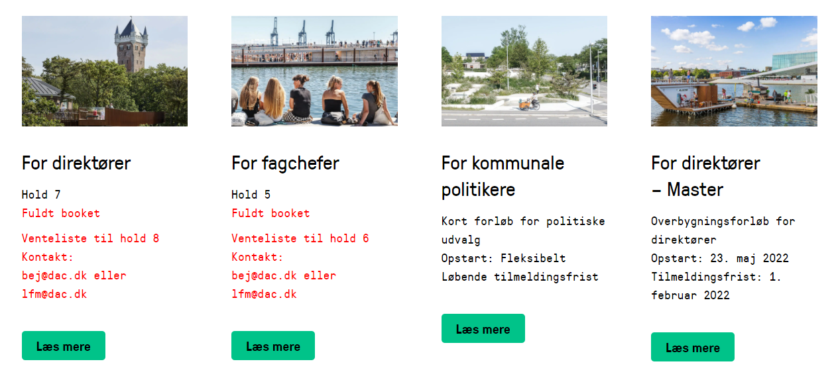
Strategic Urban Governance

Slide 3
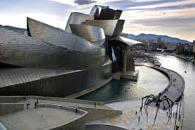
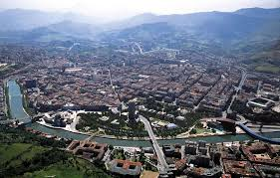


Slide 4
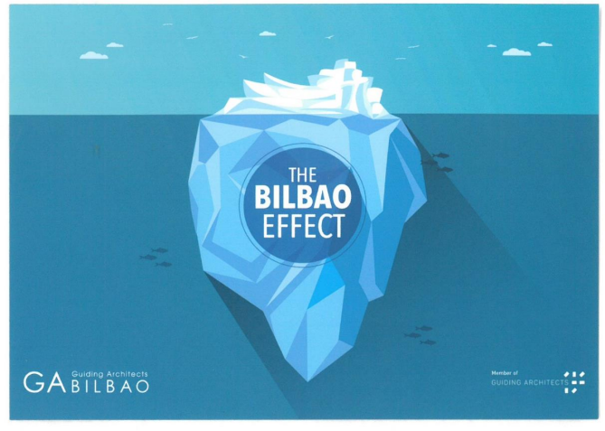

Slide 5
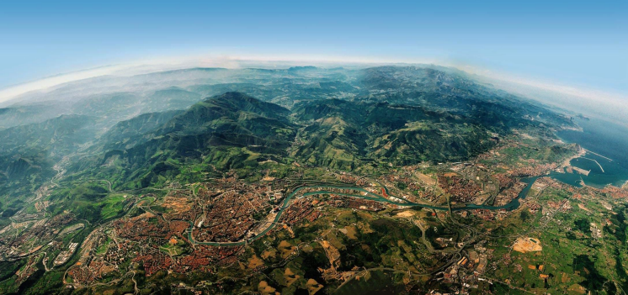
THE METROPOLITAN AREA OF BILBAO
35 municipalities centrered on the Nervion river and estuary

Slide 6
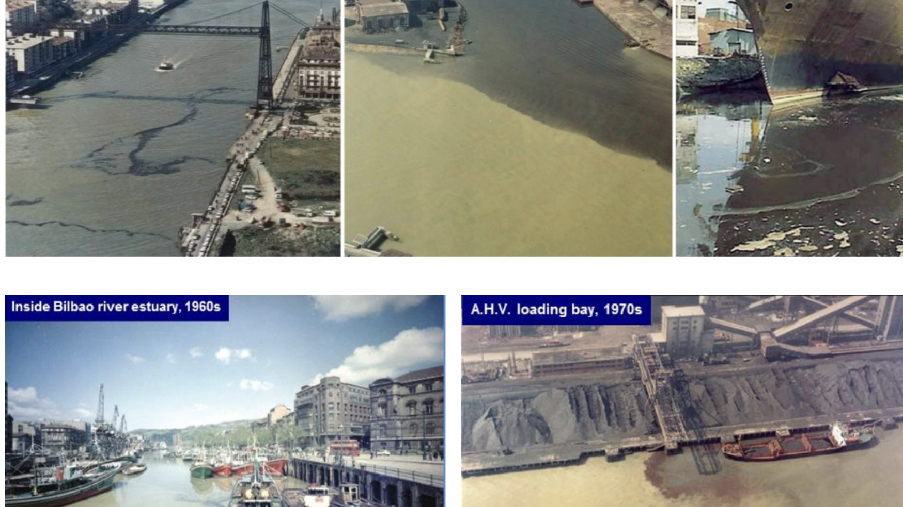

Slide 7
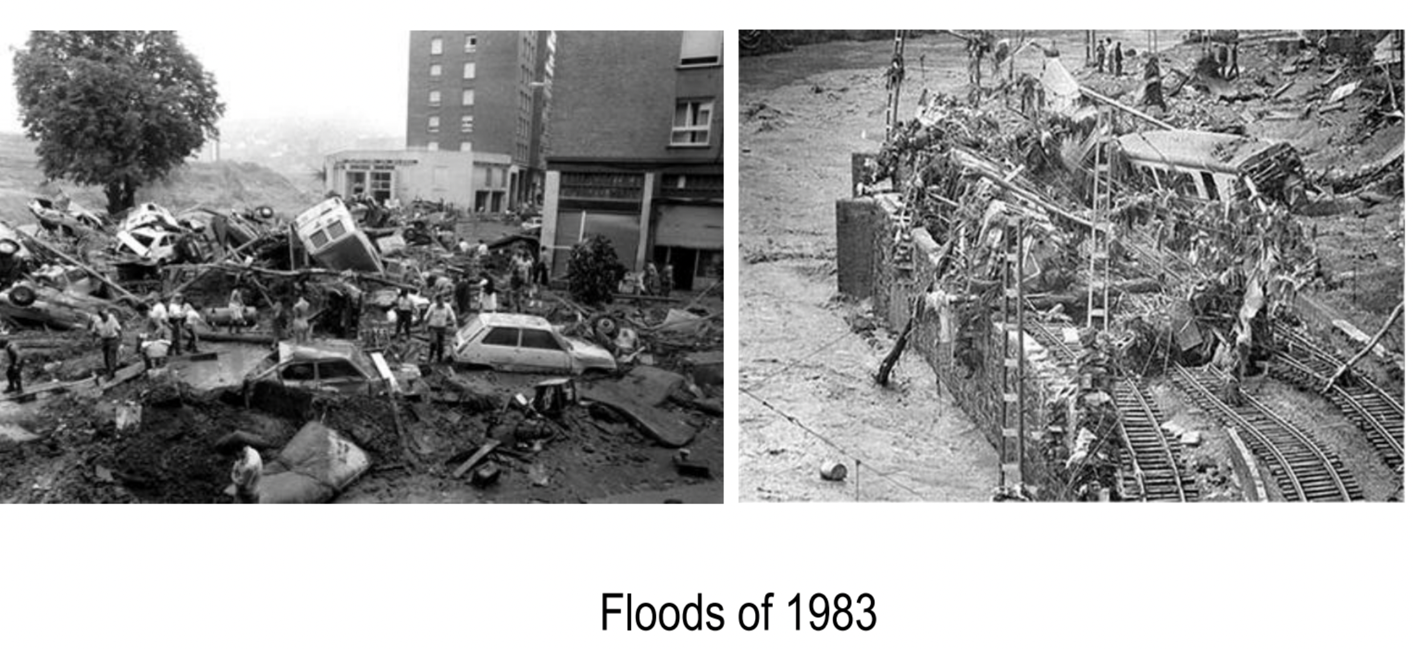

Slide 8
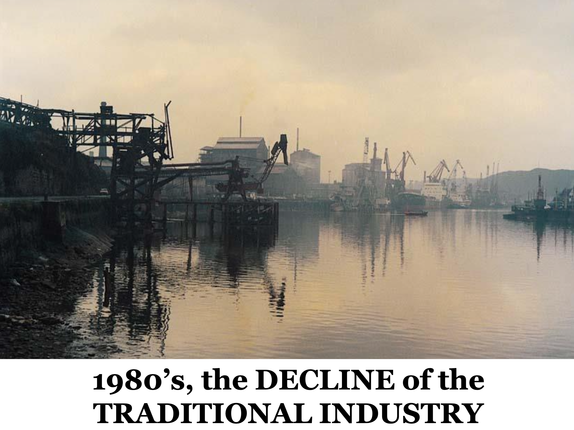
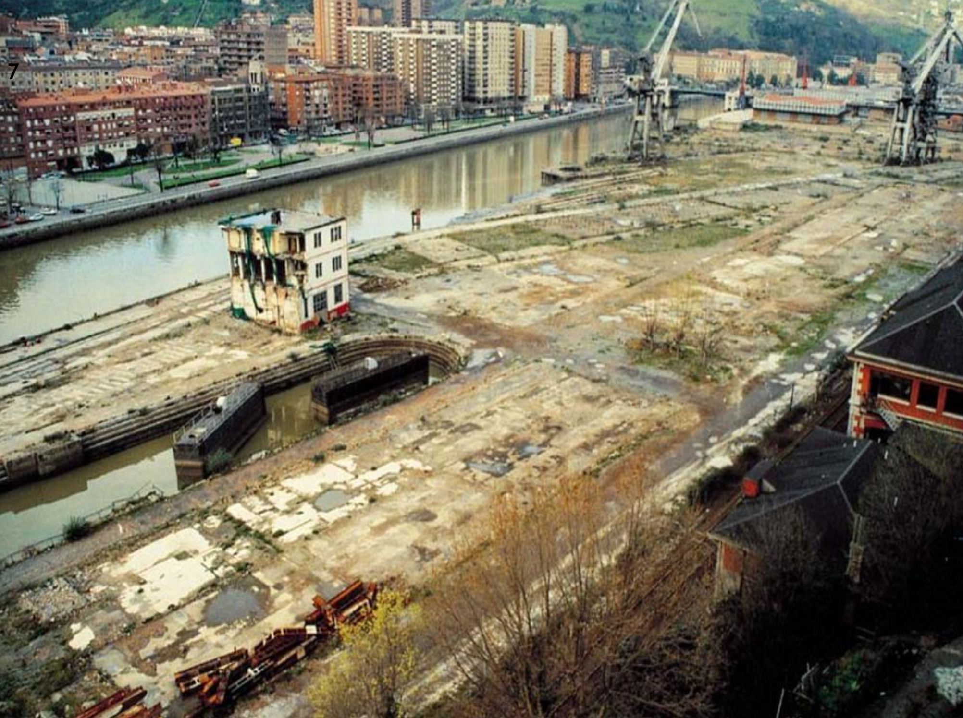
30% unemployment
Worst environment in Europe
River Nervion dead
Poor quality of life
Decreasing population
No tourism

Slide 9
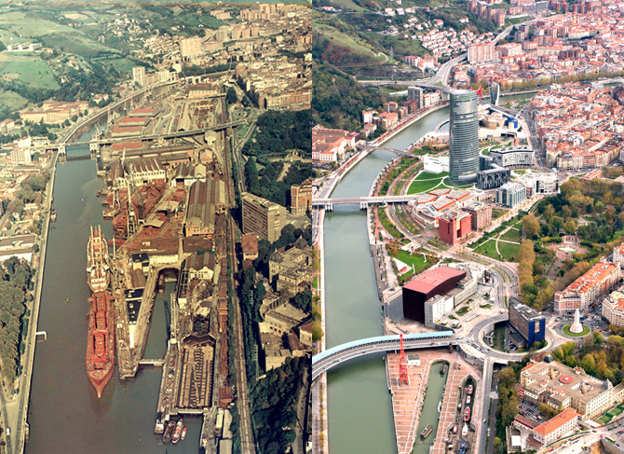

Slide 10
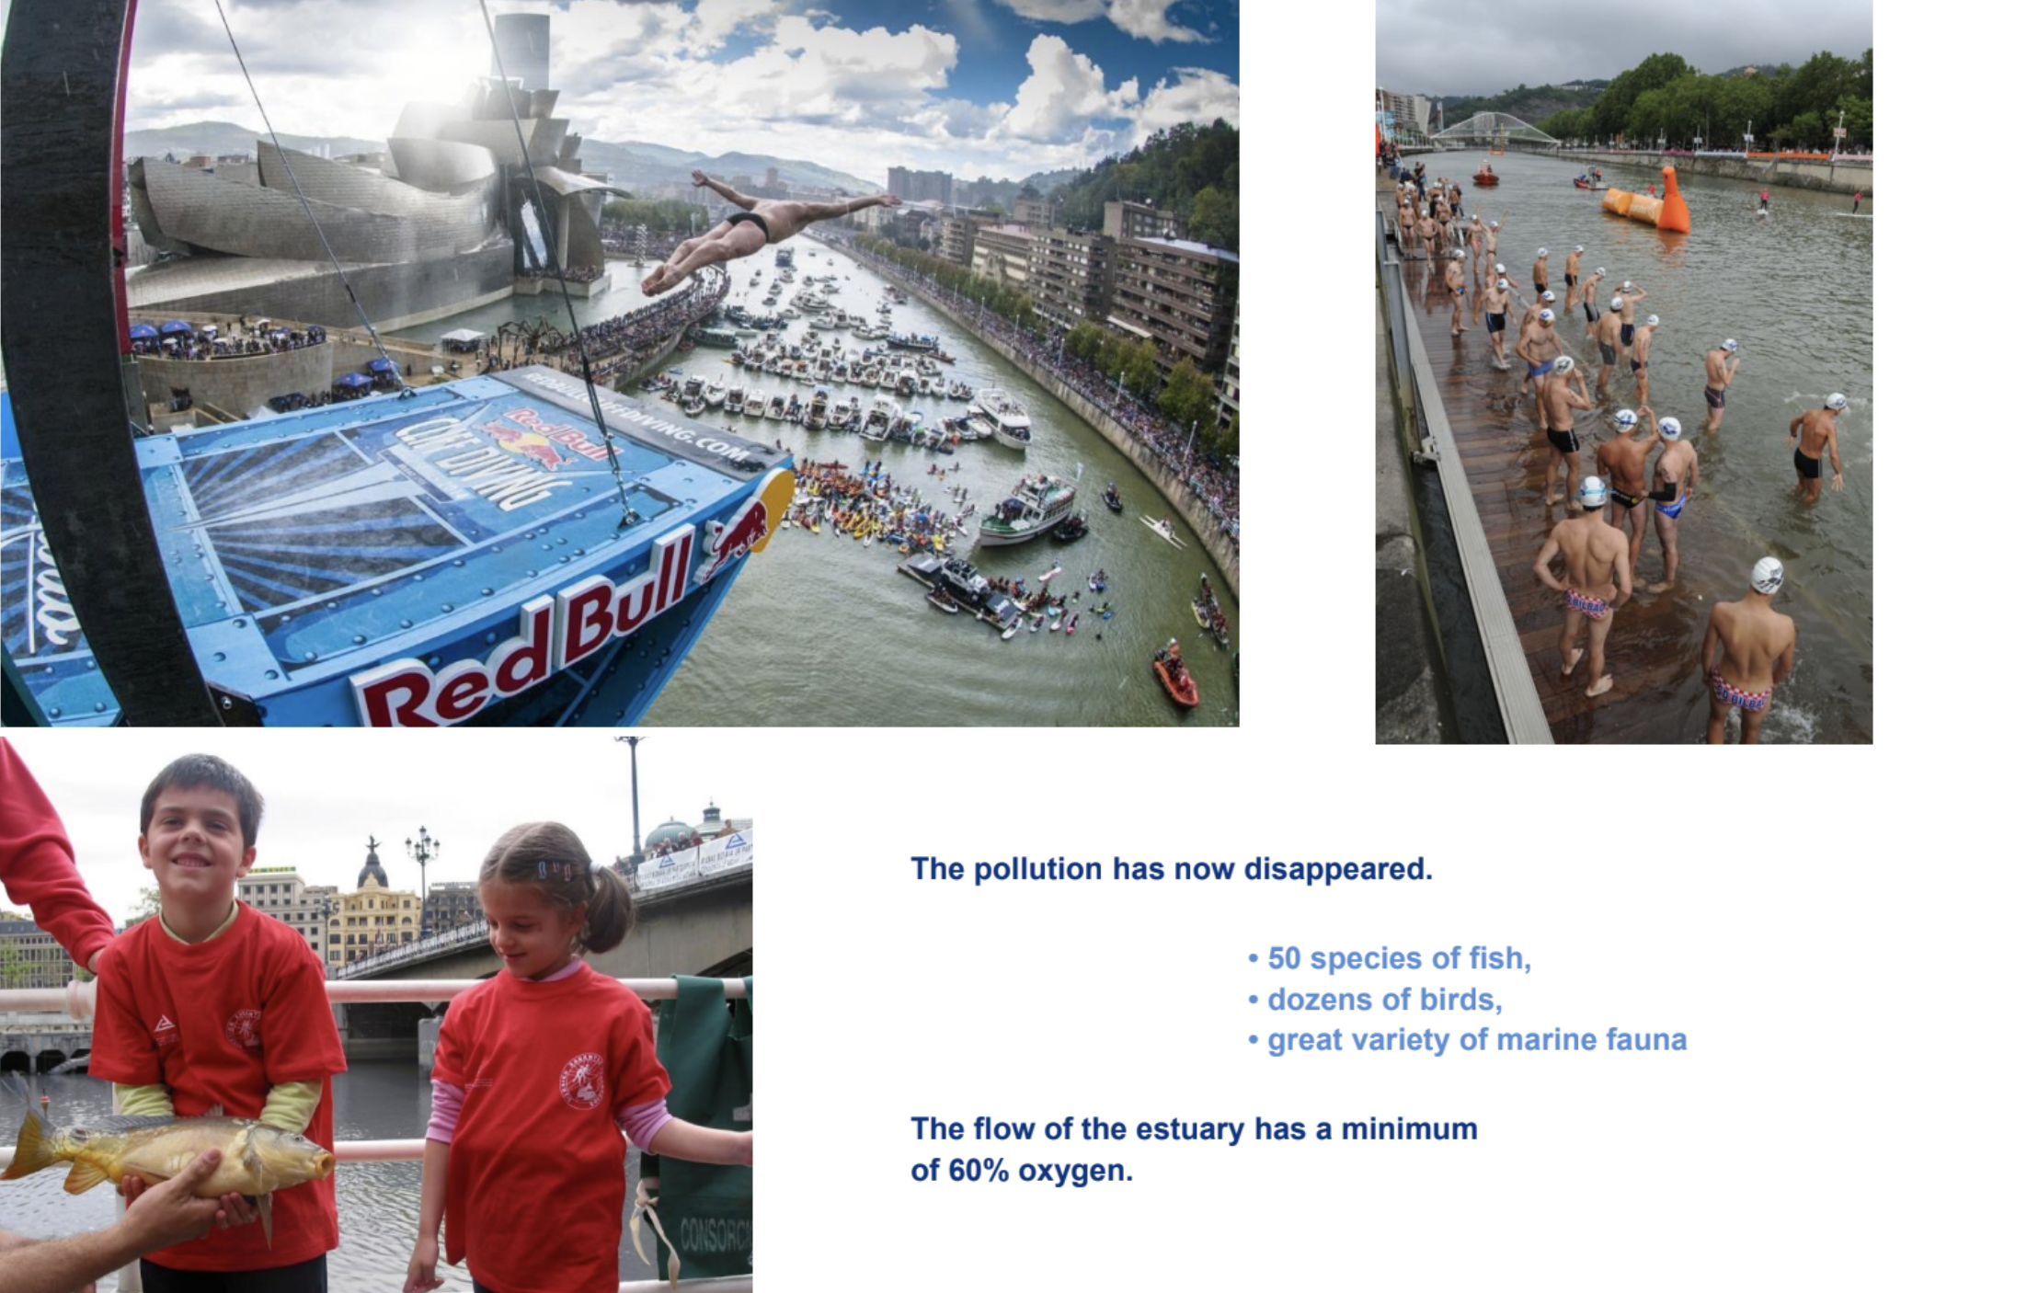
Now:
Lowest unemployment in Spain
Economic powerhouse driven by innovation and green tech
Among Europes top ‘most livable cities’
Top ranked intelligent city (IMD Smart City Observatory).

Slide 11
NOW: Green Mobility
The task: decrease accidents, congestion and pollution.
Tools: Radical change to favour public transport and soft movement.
Tight network of public transport. Cheap.
Surface parking removed.
Price for parking accelerated x10. Car commuting not attractive
Speed limit down to 30 km/h in 85% of streets (only motorways maintain high speed).
Large arteries underground/covered by city parks

Slide 12
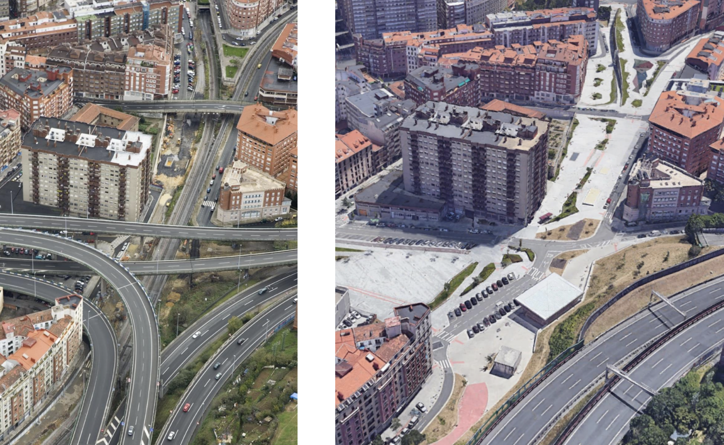

Slide 13
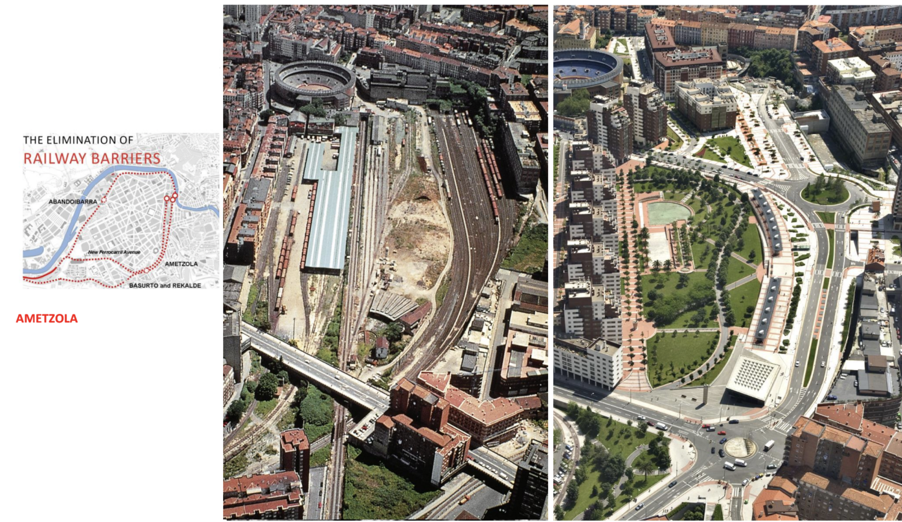

Slide 14
Results
Car transport accounts for 11% af journeys (reputedly lowest in the world)
Journeys on foot accounts for a vast majority of journeys
Air pollution cut. Now one of the cleanest cities in Europe.
Local spaces have been energized both in the centre and in the periphery. People use public space and they buy locally. The public space feels safe and democratic.
Much money has been transferred to soft mobility; which is relatively cheap and benefits many people across income and social background.

Slide 15
THE METROPOLITAN AREA OF BILBAO
35 municipalities centrered on the Nervion river and estuary

Slide 16
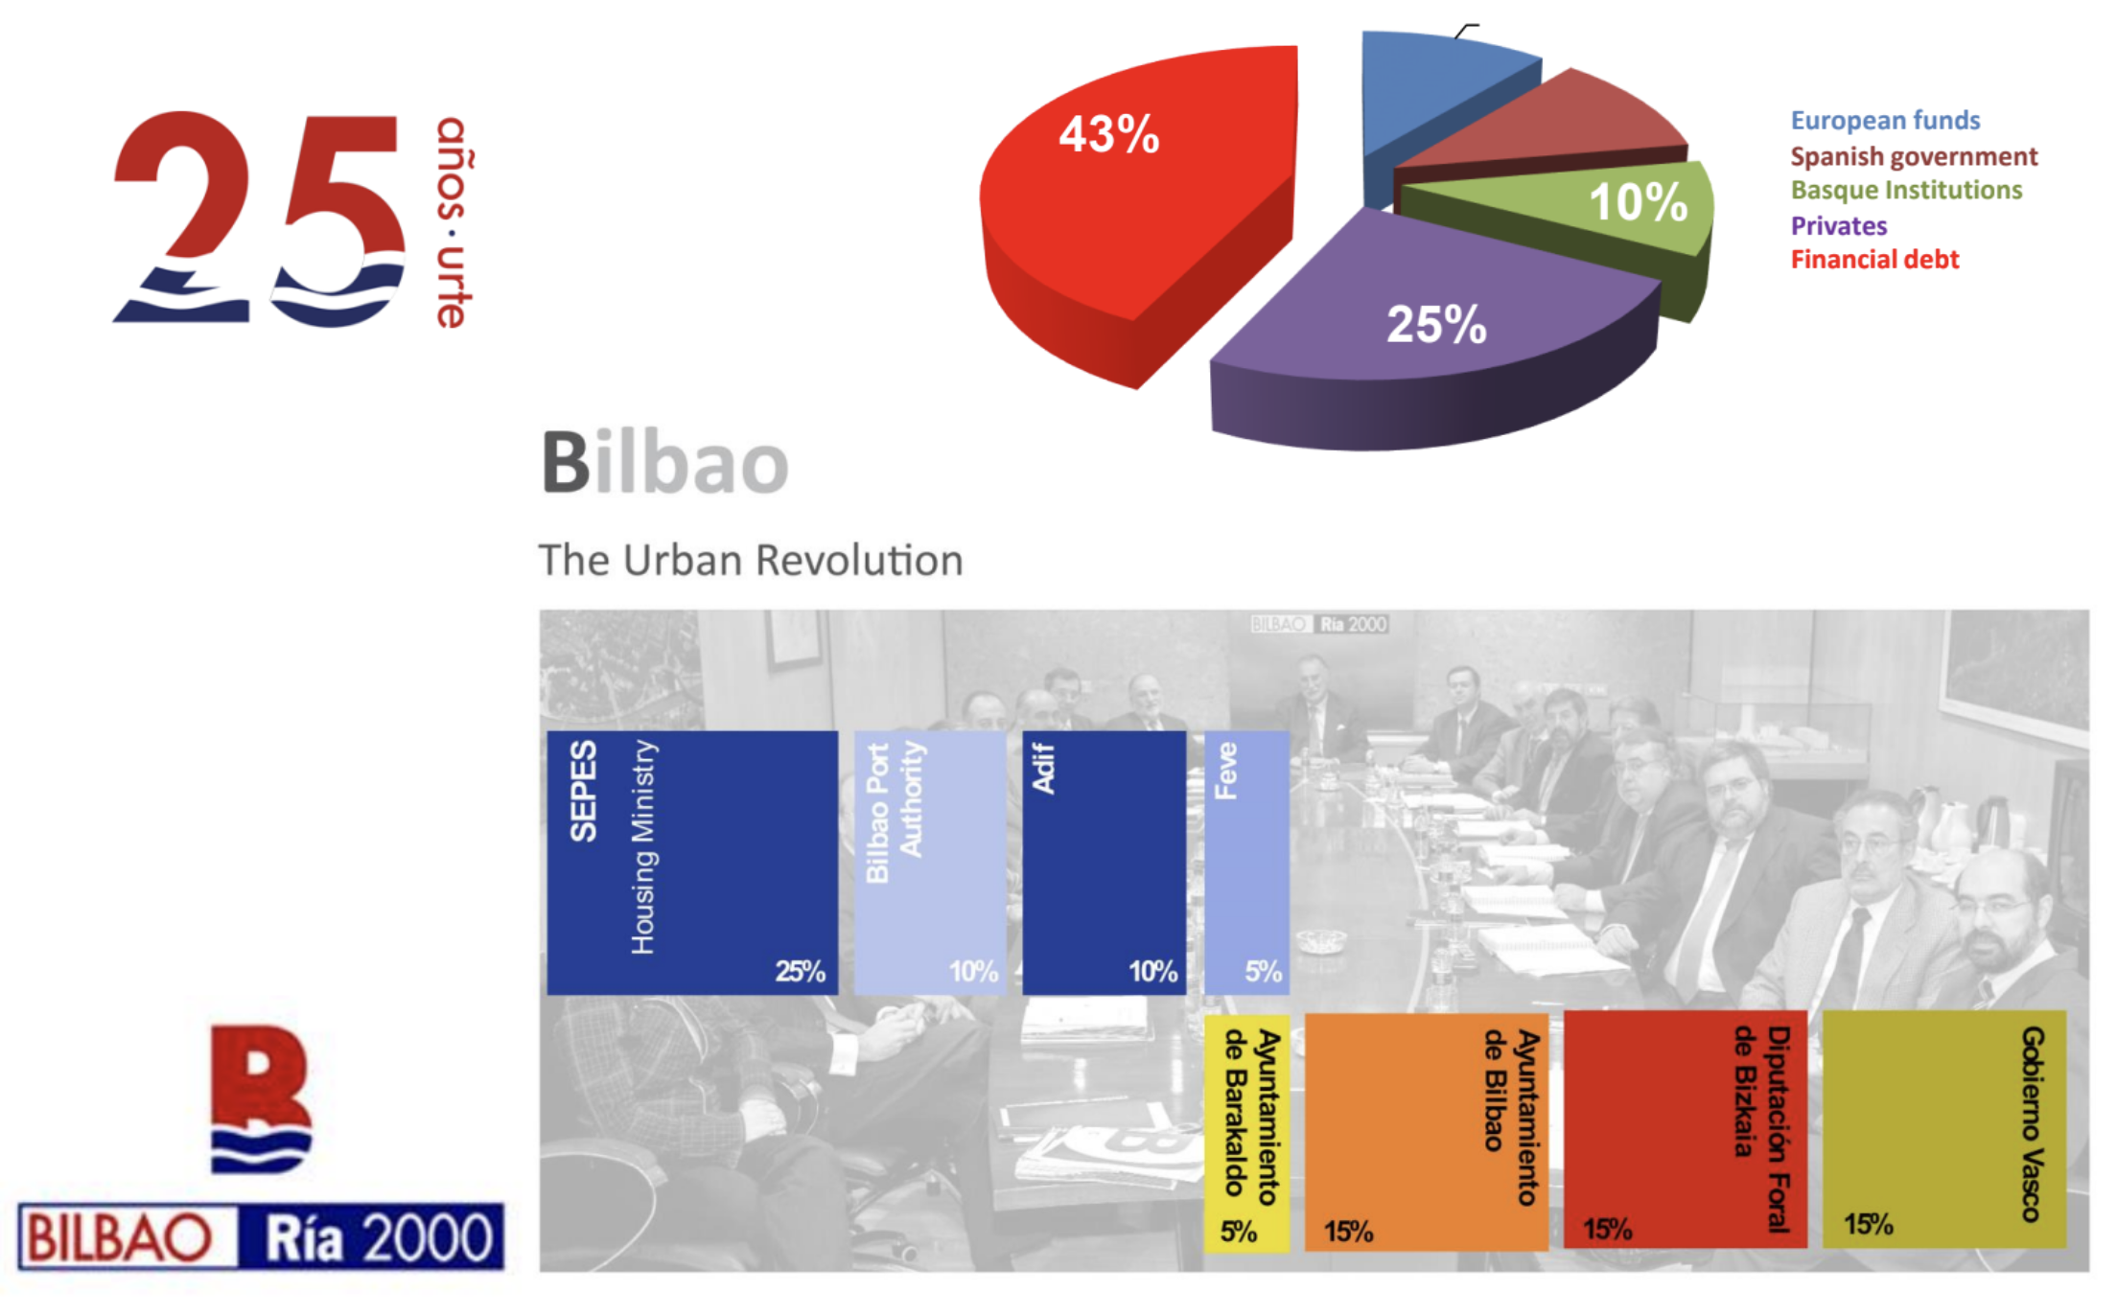

Slide 17
Leadership over structure
There was/is no planning authority or other public entity covering the region. The transformation was the responsibility of….. no one.
The people were often against the changes. Many of the major long term investments and radical changes were very unpopular in the <general public. They were true acts of leadership.
The transformation has happened despite little formal leadership. The leadership happens in partnerships across many different stakeholders. The change in green mobility happened very quickly.
In the Nordic countries we favour processes and consensus. Is this an obstacle to act fast and decisively on climate issues?

