Slide 1
HELP SHAPE A SUSTAINABLE FUTURE:
AGENDA 2030 AT THE LOCAL LEVEL
28 October 2019

Slide 2
Paula Lehtomäki
Secretary-General
Nordic Council of Ministers

Slide 3
Elin Slätmo
Nordregio

Slide 4
Who is in the room?
Representatives from
Civil society?
Researchers and academia?
Companies and think tanks?
Banks and Foundations?
Associations for local and regional authorities?
State authorities, ministries, embassies?
Local and regional authorities?
Other?

Slide 5
Invitation survey: responses from 22 organisations identified as local and regional authorities (municipality, city, region or county administration)

Slide 6
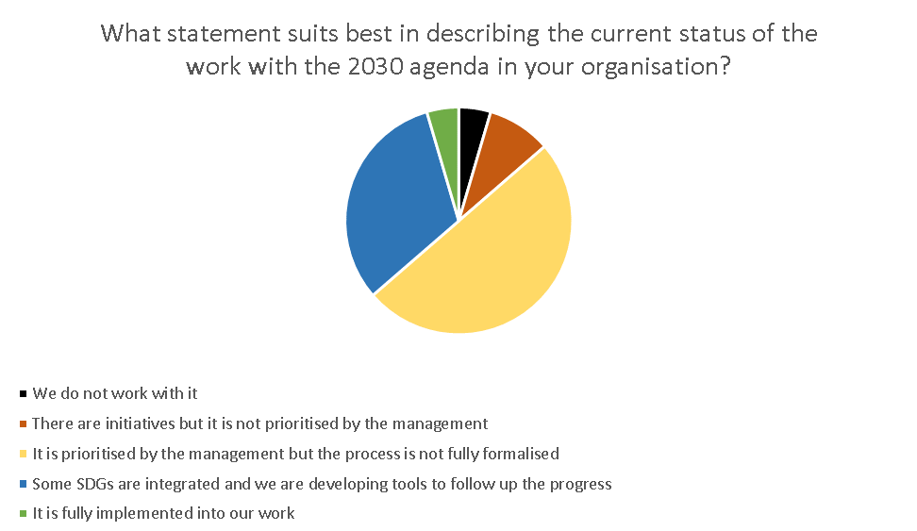
Based on responses from 22 organisations identified as local and regional authorities here at the event

Slide 7
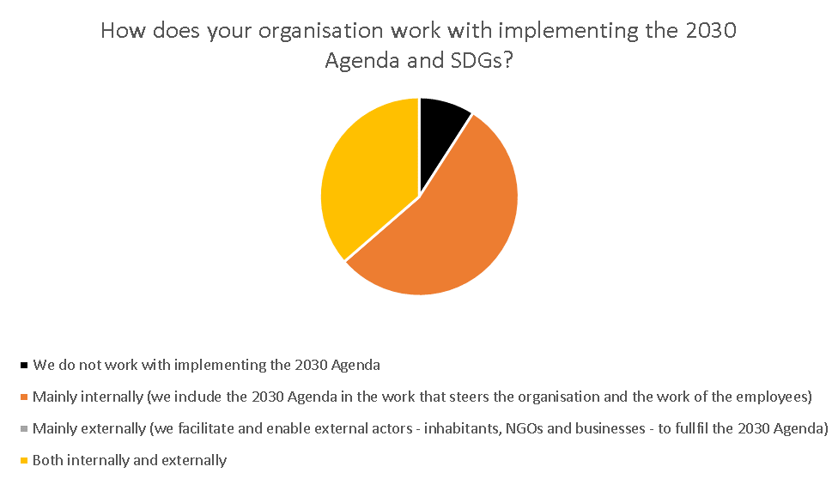
Based on responses from 22 organisations identified as local and regional authorities here at the event

Slide 8
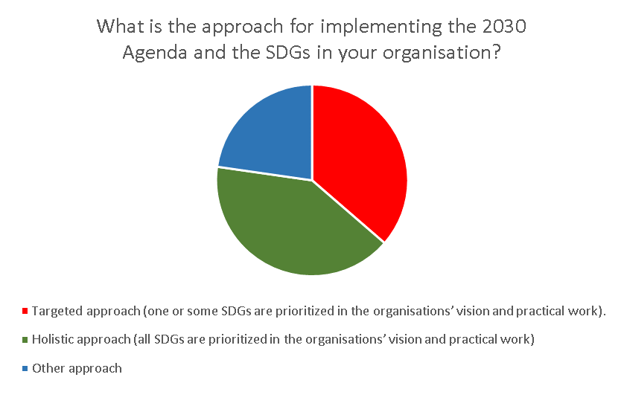
Based on responses from 22 organisations identified as local and regional authorities here at the event

Slide 9
Global Goals for Local Priorities Nordic experiences in implementing the 2030 Agenda on the local level
Elin Slätmo, Senior Research Fellow
Also in research team: Nora Sánchez Gassen, Oskar Penje

Slide 10
Questions from Nordic Council of ministers to Nordregio
Which nordic municipalities work with the 2030 Agenda and the SDGs?
How are the municipalities implementing the 2030 Agenda and SDGs?

Slide 11
Our approach:
Identify municipalities in the Nordics working with the 2030 Agenda
Asked national authorities, agencies, institutes and associations for municipalities that were implemeting the 2030 Agenda.
Contacted municipalities to see if interested to participate in the study.
Interviews with municipalities
Semi-structured interviews to enable comparisons.
Analyses and summary
Deductive categorisation of municipalities in different approaches.
Searched for similarities and differences in their responses.
Dominating challenges and success factors.

Slide 12
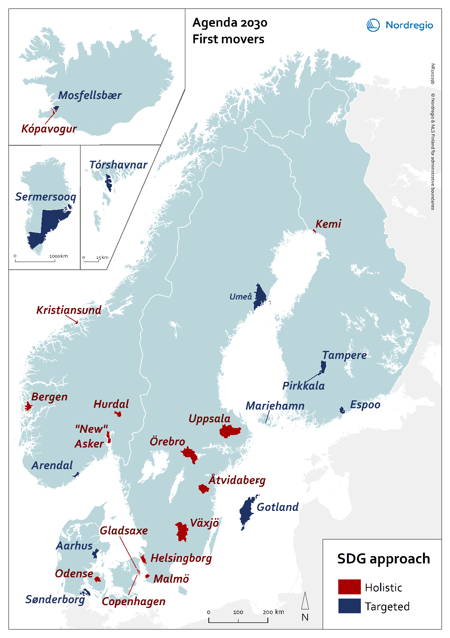
The first movers who work with the 2030 Agenda
27 municipalities in 2018:
5 in Denmark
4 in Finland
2 in Iceland
5 in Norway
8 in Sweden
1 on Åland
1 on the Faroe Islands
1 in Greenland

Slide 13
How do the Nordic municipalities work with the SDGs?
Holistic approaches.
Targeted approaches.
But many differences:
Number of SDGs that are prioritised.
Organisation of the work within local authorities.
Involvement of the inhabitants, businesses, civil society, research.

Slide 14
Cross-nordic challenges
Integrating the work internally in the local authority.
Integrating the work externally (businesses, civil society, inhabitants, research).
Make the global relevant at the local level.

Slide 15
In the beginning it was tricky to make people understand the 2030 Agenda and SDGs, what they are about and how they relate to Odense. The first SDG is on ‘zero hunger’. When we started to talk about the SDGs, audiences were often a bit confused how the SDGs would matter for Odense, because of the first goal. Perhaps it seemed more of an issue in the developing world. “
OFFICIAL IN ODENSE MUNICIPALITY, DENMARK, MARCH 2018.

Slide 16
Cross-nordic Success factors
Create and tell a common story about the future of the municipality (or region).
Relate the SDGs to ongoing local activities.
Support and mandate for the work with the SDGs from the leader(s) in the organisation.

Slide 17
Some recommendations from the Nordics
Define priorities and concrete local goals.
Set up a committee to coordinate the work.
Involve all local departments and local politicians.
Integrate the SDGs into key steering documents and/or the budget.
Involve the population (young people!), local businesses and organisations.
Network and learn from others.

Slide 18
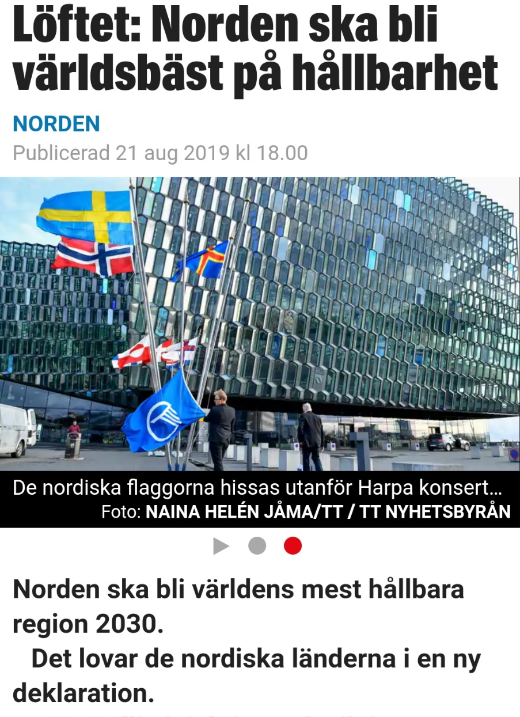
Updated policy recommendations
The outcome of todays event is intended to form the base for new policy recommendations for the Nordic Council of Ministers.
We hope that organising this day can give an updated understanding on needs from local and regional authorities.
Take the opportunity to engage in discussions and adress issues important for you in the parallell sessions and in the afternoon panel.

Slide 19

Thanks!
Elin Slätmo, Senior Research Fellow
elin.slatmo@nordregio.org
Nora Sanchez Gassen, Senior Research Fellow
nora.sanchezgassen@nordregio.org
Oskar Penje, Cartographer/GIS Analyst
oskar.penje@nordregio.org
The report from 2018 can be downloaded here http://norden.diva-portal.org
In English or in Scandinavian (Swedish).

Slide 20
Stefano Marta
OECD

Slide 21
A Territorial Approach to the SDGs
Agenda 2030 at the Local Level
28 October 2019, Stockholm
Stefano Marta
Programme Coordinator
OECD Programme A territorial approach to the SDGs

Slide 22
Rationale for a Territorial Approach to the SDGs
OECD Action Plan on SDGs: i) key role of subnational governments and ii) need to look beyond national averages
Leaving no one behind is a shared responsibility
100 out of the 169 SDGs targets require subnational governments to be achieved
A tool for policy making - going beyond the compliance agenda to:
Set a vision and re-orient existing strategies and plans
Plan coherently and consistently (multi-level)
Manage trade-offs and promote synergies across sectors
Revamp local and regional development priorities
Prioritise investment and allocate budget
Engage stakeholders, in particular private sector and civil society
Push forward the statistical fronteer
Notes:
Which are the opportunities offered by SDGs to cities and regions?
The SDGs provide a key framework to re-orient existing strategies and plans as well as to shape new ones towards sustainable development. At the same time, they can help identify place-based priorities for the strategies and plans;
The SDGs allow going beyond a silo approach and promote synergies among sectoral policies. The interconnected and indivisible nature of the SDGs can contribute to promote horizontal coordination among sectoral policies and to strengthen the linkages among social, economic and environmental dimensions;
The SDGs can help cities and regions improve vertical coordination with other levels of government, in particular with their national governments. They can be used to align priorities – for example some cities and regions are prioritising their goals/targets starting from the prioritisation conducted by their national governments;
The SDGs are a powerful tool to strengthen partnership with private sector. Private companies are increasingly integrating the SDGs into their core business, going beyond corporate social responsibility. The SDGs therefore can become a common framework and language to develop private-public partnerships;
The SDGs are becoming a tool to engage and institutionalise processes with the civil society and citizens, in particular the youth. This can lead to co-designing visions and strategies with territorial stakeholders. It also enhances accountability and transparency in the policy-making process;
The SDGs indicators framework allows pushing forward the statistical frontier. It also provides a common sets of targets and indicators that allow cities and regions for benchmarking with national averages and with their peers;
The SDGs are starting to be used as a tool for budgeting, both by national and sub-national governments. Cities and regions are allocating resources based on the prioritised goals/targets. This also allows to allocate resources not only by traditional sectors, but also by integrated multi-sectoral programmes and priorities;
The SDGs can represent also a powerful tool to implement national territorial reforms (e.g. merging municipalities and counties) and promote inter-territorial cooperation, going beyond administrative borders and promoting a functional approach to address key local challenges (e.g. transport, mobility, waste management, among others).
Cities and regions engaging with the SDGs should not consider the 2030 Agenda as an additional agenda on top of all the others, but as a framework to improve strategies, policies and their implementation.

Slide 23
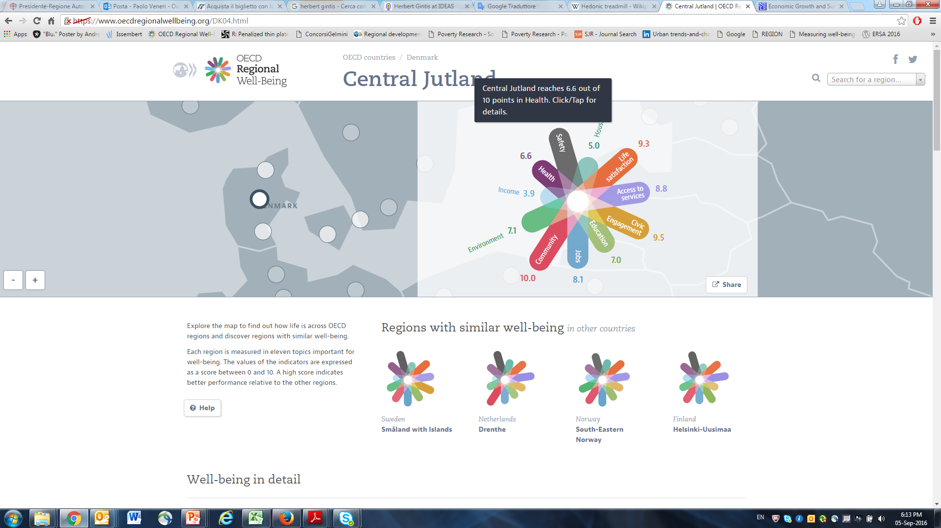








OECD Programme Objectives
Measuring
Learning
Sharing
A tailored, consensual and localised indicator framework
Policy Recommendations
Analyse & discuss local SDGs stories/evolving practices
Harmonised and comparable OECD territorial statistics for SDGs
Common OECD/EU definition of « city » and « region »
Draw lessons in terms of incentives, processes, outcomes
Pilot-test the indicator framework in different contexts
Peer-to-peer dialogue between cities, regions and national government
Twinning during field trips and missions
Engagement of umbrella/city networks and stakeholder groups
Province of Córdoba | Argentina
Region of Flanders | Belgium
Region of Southern Denmark | Denmark
City of Kitakyushu | Japan
City of Bonn | Germany
Municipality of Kópavogur |Iceland
County of Viken | Norway
City of Moscow| Russian Federation
State of Paraná| Brazil
Notes:
OECD Action Plan on SDGs: i) key role of subnational governments and ii) need to look beyond national averages
Leaving no one behind is a shared responsibility
100 out of the 169 SDGs targets require subnational governments to be achieved
Subnational governments responsible for almost 60% of total public investment in 2016 in OECD area and for almost 37% worldwide
SDG11 on cities is central, but we need a territorial lens for all SDGs
SDGs are a means to promote policy coherence and manage trade-offs
A Territorial Approach helps to prioritize, plan and budget

Slide 24
Highlights from the OECD-CoR Survey: The key contribution of regions and cities to sustainable development
Notes:
From 13 December 2018 to 1 March 2019, the European Committee of the Regions (CoR) and the OECD carried out an online survey on "The key contribution of regions and cities to sustainable development”. The survey gathered valid answers from 400 respondents
Level of Awareness:
59% of respondents are familiar with the SDGs and currently working to implement them. .
Among respondents representing regions or large or medium cities (more than 50 000 inhabitants) this share rises to approximately 80% or more, while for small municipalities the share is 37%.

Slide 25
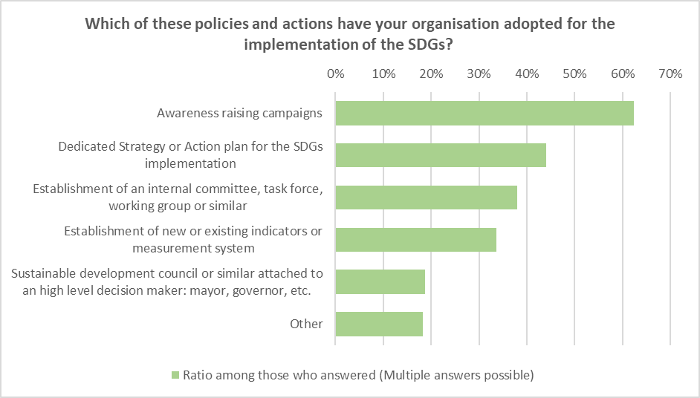
Policies and Actions for the implementation of the SDGs
Source: CoR-OECD Survey (2019) The key contribution of regions and cities to sustainable development
Notes:
The most common action put in place in order to implement the SDGs is awareness raising campaigns, selected by more than 60% of the respondents
Having a dedicated strategy/action plan and establishing indicators are two of the key elements of a relatively advanced stage of implementation of the SDGs and these were selected by 44% and 34% of respondents
Among the "other" actions and policies, many respondents mentioned the integration of the SDGs in the organisations' plans and strategy, or intentions to do so in the future.

Slide 26
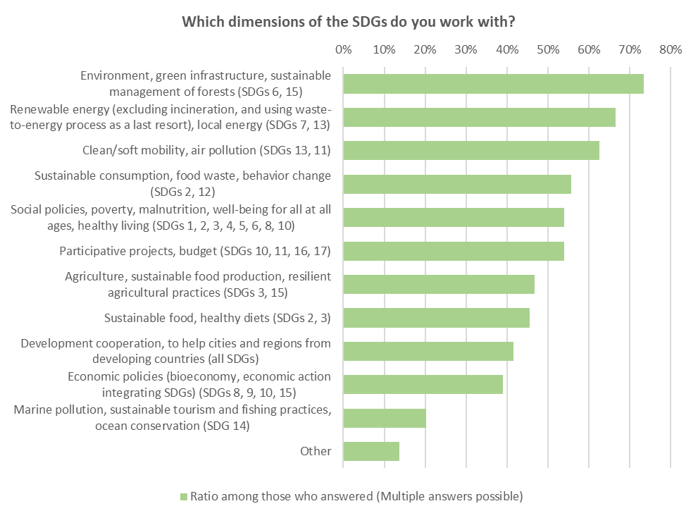
Sectoral Priorities
Source: CoR-OECD Survey (2019) The key contribution of regions and cities to sustainable development
Notes:
In terms of sectors, the most common dimension of the SDGs tackled by respondents is the environment (73%), closely followed by energy (67%) and mobility (63%): environmental bias in EU cities/regions
Sustainable consumption, social policies and participative projects also scoring high (more than 50% of respondents).
The diversity of sectors receiving high scores highlights that the cross-sectoral and multi-dimensional nature of sustainability and of the SDGs is taken into account

Slide 27
Main Challenges
Source: CoR-OECD Survey (2019) The key contribution of regions and cities to sustainable development
Notes:
In terms of challenges, respondents predominantly highlighted "Lack of awareness, support, capacities or trained staff" (50% of all respondents) and "Difficulty to prioritise the SDGs over other agendas" (49%) as key challenges.
Difficulty to prioritise the SDGs over other agendas: this response highlights a lack of awareness on the 2030 Agenda: the 2030 Agenda should not be considered an additional agenda, but a framework to improve LRGs’ strategies, policies, actions, etc
the share of respondents citing "insufficient financial resources" as a challenge is not significantly different among respondents from small municipalities compared to the broader sample.

Slide 28
Key lessons from the pilots
SDGs as a tool for strategic visioning, planning and budgeting
SDGs as a framework to manage trade-offs across sectoral policies
SDGs to engage the private sector and civil society beyond CSR
Need for a comparable and localised SDGs indicator framework

Slide 29
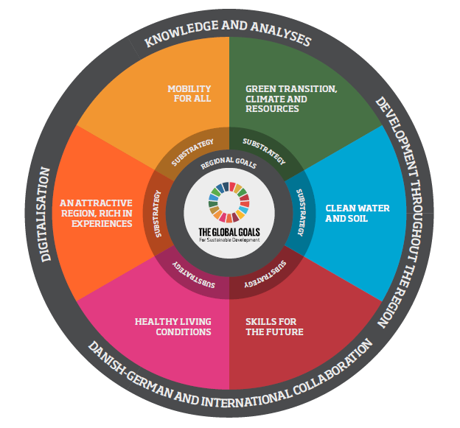
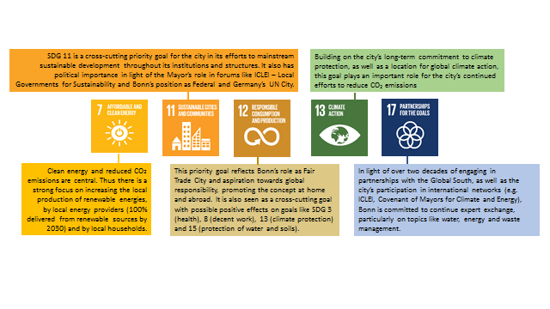
A Tool for Strategic Visioning, Planning and Budgeting
Key findings from pilots :
Using the SDGs as a checklist for ongoing programmes and activities (e.g. Moscow);
Adapting existing strategies/plans to the SDGs (e.g. Flanders, Cordoba, Parana);
Developing new plans/ strategies though the SDGs (e.g. Bonn, Southern Denmark, Kitakyushu, Kopavogur, Viken).
The new Regional Development Strategy (2020-23) of Southern Denmark
Key SDGs for the sustainability strategy of the city of Bonn

Slide 30
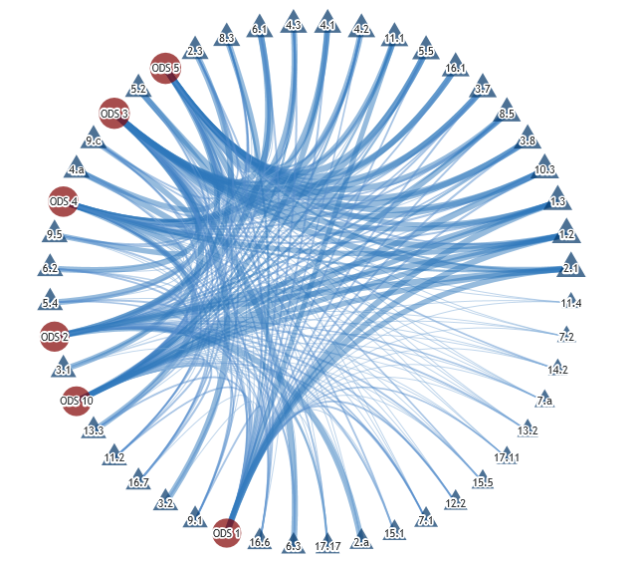

A Tool to manage sectoral trade-offs
Pilot | Horizontal coordination approach
Bonn (Germany) | Project and Steering Groups set up with representatives from all city departments to input to the development of the local sustainability strategy, which implements priority SDGs. It remains unclear if this structure will be institutionalised beyond the strategy development
Córdoba (Argentina) | Inter-ministerial Roundtable of awareness and adaptation of the SDGs set up, coordinating all the provincial departments that are developing the processes of prioritisation and alignment of their policies to the targets and goals (Ministries, Secretariats and Agencies)
Flanders (Belgium) | New governance model based on transition principles: system innovation, taking a long-term perspective, involving stakeholders through partnerships, engaging in co-creation and learning from experiments The model is organised around “transition spaces” managed by teams composed of transition managers from the public administration, responsible ministers and external stakeholders
Kitakyushu (Japan) | Kitakyushu SDGs Headquarters, SDGs Council and SDGs Club to ensure both horizontal coordination and multi-stakeholder engagement in the implementation of the SDGs Future City Plan
Kópavogur (Iceland) | Steering Group set up for the development of the local strategy with all heads of department, while the strategy’s Project Group coordinates the contents and strategic action plans by all departments to implement the strategy
Southern Denmark | An interdisciplinary working group has been set up to identify how the SDGs can be integrated in regional development
Viken (Norway) | New county organisation built on the SDGs, where the goals become a new management responsibility and part of everyone’s daily tasks and routines
Inter-linkages& Synergies Matrix in the province of Cordoba, Argentina

Slide 31
A tool to engage private sector and civil society
Promoting platforms for coordination, in particular with SMEs (e.g. Cordoba, Bonn)
De-risking private investments for innovative SDGs projects (e.g. Viken)
Sustainability as a competitive advantage, but need for willingness to pay by customers (e.g. Denmark)
Key role of sustainable public procurement (e.g. Parana, Southern Denmark, Flanders)
Pilot | How is civil society involved ?
Bonn (Germany) | Participation by CSOs in the project working group for the sustainability strategy to input and feedback on the strategy contents
Córdoba (Argentina) | Open Government Roundtable as a forum to engage multi-stakeholder dialogue Need for better coordination of CSOs’ actions towards the SDGs
Flanders (Belgium) | Transition spaces and strategic advisory councils provide formal spaces and mechanisms for consultation and collaboration between stakeholders, including CSOs Civil society platform Perspective 2030 lobbying for strong accountability by all governments
Kitakyushu (Japan) | SDGs Council and SDGs Club open to CSOs and local citizens Long tradition of civil society as pro-active change agents in the city
Kópavogur (Iceland) | Involvement of civil society in the strategy development was limited at the initial stages Participatory budgeting initiative (OKKAR) will be linked to the SDGs and new online tools for participation are being developed
Southern Denmark | Collaboration between civil society and municipalities to foster integration of asylum seekers and long-term unemployed
Viken (Norway) | Involvement of CSOs and local citizens as formal requirements of the Regional Planning Strategy process
SDGs Council to engage local stakeholders in Kitakyushu (Japan)
Citizen
Partnership
Government
Private sector
Source: Kitakyushu City the SDGs Report 2018

Slide 32
OECD Localised Indicator Framework
Around 117 indicators that allow monitoring progress in 60 out of the 103 targets identified as very relevant for regions and cities from OECD countries (in progress)
% of subnational Targets with at least one available indicator, by Goal
Notes:
The OECD estimates that at least 100 out of the 169 SDGs targets require the full engagement and participation of subnational governments to be achieved in all OECD regions and cities.
Process to develop the framework:
I) What targets and indicators are relevant at the subnational scale? Place-relevant vs. place-neutral
ii) What targets and indicators are relevant in OECD countries? Developed vs. developing country
At Which Scale?
Regions: first administrative tier of subnational government or TL2 Large Regions.
Coverage: 600+ TL2 Large Regions of 48 countries (36 OECD and 12 partners):
400 OECD TL2 large Regions
+ TL2 large Regions of 5 LAC countries, 5 EU28 countries, Tunisia and Russia
Cities: Metropolitan areas or Functional Urban Areas of more than 250K people.
Coverage: 600+ FUAs of 33 OECD countries and Colombia
628 OECD FUAs
+ FUAs of Colombia
+ Combination of Functional and Administrative Data.

Slide 33
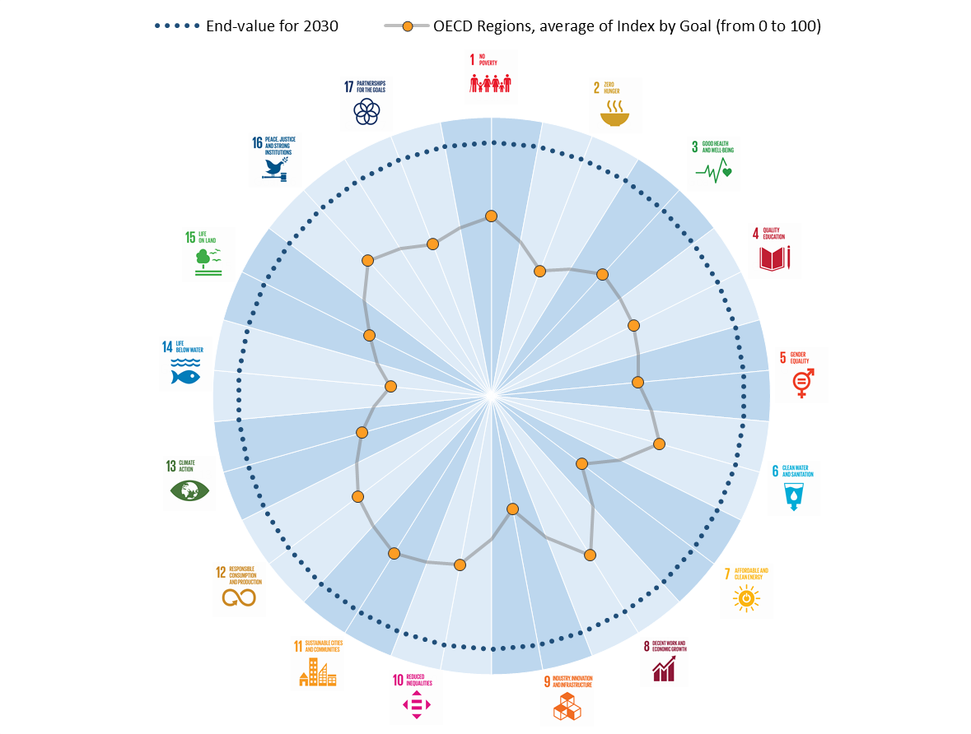
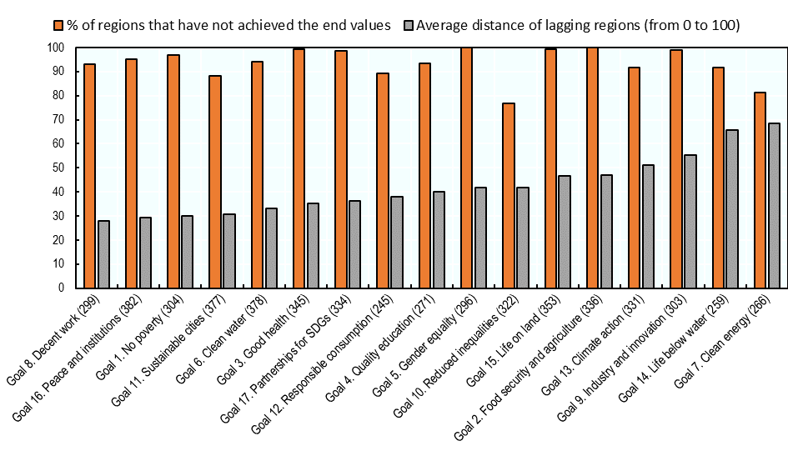
Preliminary results (work in progress)
Distance of OECD Regions to the end values for 2030, by Goal
Share of Regions that have not achieved the end values for 2030, by Goal
Notes:
The average distance of OECD regions to the end values for 2030 varies across the 17 Goals and ranges from 25 to 60% of the total possible distance to achieve the desired outcomes. The average distance of a region or city to an end value is the remaining trajectory the region or city has to travel as a percent of the longest distance a region or city could face in a given indicator or index. While the average distance to achieve Goals 8 “Decent work”, 11 “Sustainable cities”, 16 “Peace and Institutions”, and 1 “No poverty” is on average less than 30% of the total possible trajectory, Goals 9 “Industry and innovation”, 7 “Clean energy”, and 14 “Life below water” are, on average, slightly above halfway from the end values. In Goal 10 (Reduced inequalities), Goal 12 (Responsible consumption), Goal 3 (Good health) and Goal 17 (Partnerships for SDGs), regions are, on average, one third of the way to reach the end values for 2030
In all the 17 Goals, at least 75% of OECD regions have not achieved the end values for 2030. Not a single region in the OECD has achieved the end values set for Goal 5 on gender equality and Goal 2 on food security and sustainable agriculture, and only around 11% of OECD regions have achieved the end values of Goal 11 on “Sustainable cities” and Goal 12 on “Responsible consumption” (both Goals with two indicators). The figure (second figure in the slide) also presents the average distance of the lagging regions – regions that have not achieved the end value – by Goal. Goal 13 (Climate action), 9 (Industry and innovation), 14 (Life below water) and 7 (Clean energy) display the largest distances to the end values for lagging regions, with an average distance above the 50%. Goal 7 about clean energy displays high regional disparities in distances to the objective. While 20% of the regions have completed the Goal’s end value (therefore having a distance to travel equal to zero), the remaining 80% of regions average a distance higher than two thirds of the total way to travel

Slide 34
THANK YOU

Slide 35
PARALLEL SESSIONS
How to get started: Room 4
How to implement: Room 6+7
How to follow up: Room 5

Slide 36
PARALLEL SESSIONS
Environmental: Room 4
Social: Room 5
Economic: Room 6

Slide 37
Messages for the Ministers

