Slide 1
Pros and cons of taking part of the banking union
Karolina Ekholm
Financial Regulation and Macroeconomic Stability
Helsinki 12 December 2012

Slide 2
The three pillars of the European banking union
Common for all EU members:
Single Rule Book
CRDIV/CRR
BRRD
SSM
SRM
EDIS
Single Supervisory Mechanism
Single Resolution Mechanism
European Desposit Insurance Scheme

Slide 3
The Single Supervisory Mechanism (SSM)
The ECB is the direct supervisor of ”significant” banks.
  116 institutions covering more than 80 percent of total assets
  Ultimately responsible for all supervisory tasks
Single Supervisory Board (SSB) consists of 25 voting members.
Formal decisions are taken by governing council under a non-objection procedure.

Slide 4
Safeguards for potential non-euro members
No objection from GC
Everyone is happy
Non-euro MS agrees
Non euro MS can declare itself not bound by the decision. GC can then suspend or terminate its membership in the SSM.
Objection by GC
Draft decision by SRB
GC upholds draft decision
Non-euro MS can leave and declare itself unbound by the decsion
Non-euro MS disagrees and notifies GC
GC alters draft decision
Non-euro MS happy

Slide 5
The Single Resolution Mechanism (SSM)
Single Resolution Board (SRB)
Responsible for resolution preparation and execution regarding significant banks and other cross-border groups.
Resolution tools:
  sale of business
  bridge institution
  asset separation
  bail-in
Single Resolution Fund (SRF)
May be used to ensure orderly resolution of banks.
  Application of bail-in rules and principles laid down in BRRD a pre-condition.
  At least 8 % of total liabilities have to be bailed in.
Built up by fees with target level of at least 1% of the amount of covered deposits by 2024.
Successive mutualization of funds.
Joining non-euro member have to transfer amount corresponding to what it would have paid if it had participated in the SSM and SRM at the outset.
Leaving non-euro member should get its contributions back.

Slide 6
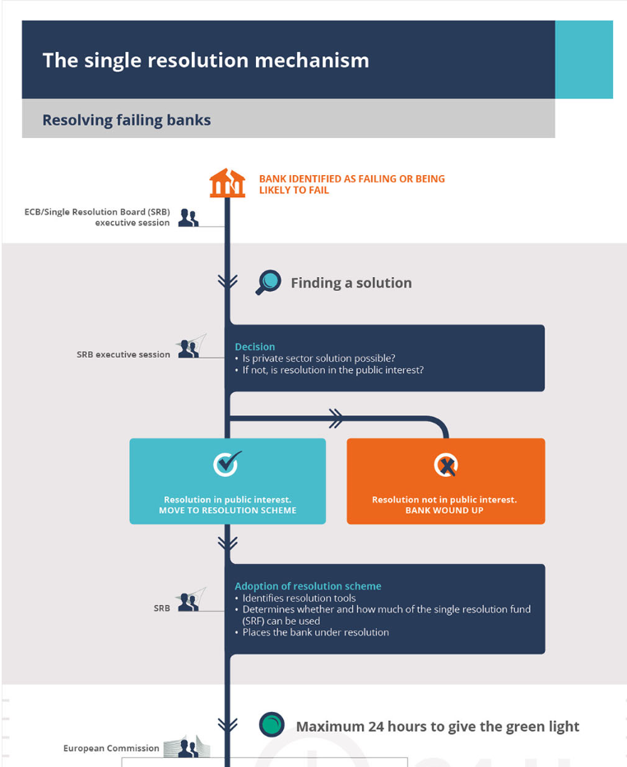
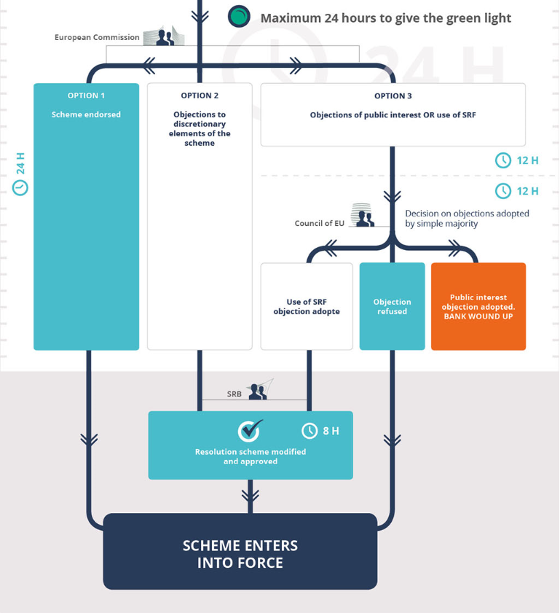
Source: Council of the European Union, General Secretariat

Slide 7
Back-stop for SRF
Back-stop provided by ESM agreed in principle, but requires changes in the ESM treaty.
  Supposed to be available by 2024 at the latest.
Should be fiscally neutral over the medium term
  Paid back with contributions from banks within three years (plus two if needed).
Non-euro members are supposed to provide the common backstop together with the SRF, through parallel credit lines.

Slide 8
Legacy issues obstacle to progress on risk-sharing elements
Non-performing loans ratios (percent of total amount of outstanding loans) in the banking union Q2 2019

Slide 9
Potential benefits of membership in a banking union

Slide 10
Benefits related to externalities from dealing with distressed cross-border banks
Liquidity problems and LOLR functions.
  Assessment of solvency may be based on better information.
Solvency problems and resolution.
  “Financial trilemma”, e.g. avoiding failure may benefit financial stability in many countries, but neither may individually have incentive to bear the cost of a bailout (Schoenmaker, 2011).
  Ringfencing leads to inefficient resolution with larger overall costs for taxpayers (e.g., Bolton and Oemke, 2019, on SPE vs. MPE strategies).
How liquidity support in resolution would work is unclear.
Financial stability
National supervision
Integrated financial markets

Slide 11
Benefits related to externalities from distressed Sovereigns
May weaken the “doom-loop” between banks and sovereigns in a monetary union.
  Motivation for centralized supervision in Farhi and Tirole (2018):
    Banks’ incentives to hold domestic debt higher in distress because the value of the put on taxpayer money through bailouts is higher.
    Sovereign has incentive to allow large concentrations because it shares the potential cost with other countries.
  For non-euro members, cross-border externalities of a sovereign default may be too small to make this argument valid.

Slide 12
Other potential benefits
Better supervision
Stronger influence

Slide 13
Potential costs of membership in a banking union

Slide 14
Costs associated with loss of control in a distressed situation
Loss of regulatory and supervisory independence.
  Decision to declare a bank failing or likely to fail taken at ECB.
Potentially poorer governance of resolution procedures.
Bail-in and contagion risk.
  Bail-in of creditors is a channel of contagion.
  Creditors of low-risk banks are more likely to be bailed in inside the banking union.

Slide 15
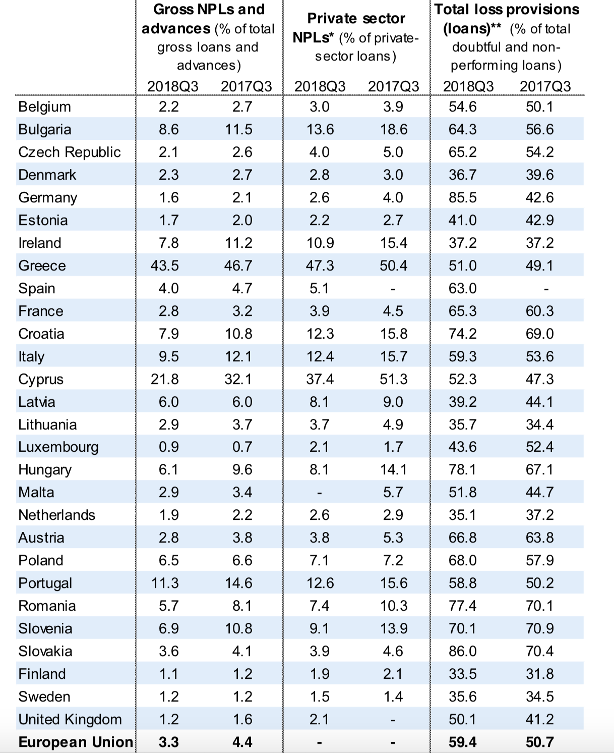
Costs associated with mutualizing risk
Increased exposure for taxpayers as long as risks are significantly higher in other members.
Source: “Communication from the Commission. Fourth Progress Report on the reduction of non-performing loans and further risk reduction in the Banking Union”, 2019

Slide 16
Conclusion
Uncertain benefits and costs.
Expanding the banking union is likely to bring benefits in the form of more efficient resolution of cross-border banks.
Whether it will also benefit the joining member depends on how those gains are distributed.
Net benefits are smaller for non-euro members than for euro members.
But overall costs for a joining non-euro country may be small because of the safeguards.
  Depends on how you view the political costs of leaving the banking union.

