Slide 1
Monetary policy and household debt
Comments by Karsten Gerdrup,
Norges Bank
Nordic Economic Policy Review,
12 December 2019

Slide 2
Gulbrandsen & Natvik (GN) ask important questions
Background 1: Rich body of empirical research indicates a link from credit to deep recessions
Background 2: Contentious debate on policy implications («lean» vs «clean» in MP, what kind of macro pru?)
GN takes a step back and questions the impact of MP on credit!
Risk of severe recession
Monetary policy
Household credit

Slide 3
Research questions
Agree with the research agenda that we cannot take for granted that a rise in real interest rates will reduce household borrowing
GN mentions three effects of a higher interest rate:
  Intertemporal substitution Lower debt growth
  Cash-flow effects Higher debt growth
  Fisher effects Higher debt growth
  (Income effects Lower debt growth)
Important to analyze these channels!

Slide 4
Main suggestions
The authors present partial regressions
  Other partial regressions, that may be at least as strong, indicates that house prices and income growth are important variables as well. Suggest broadening the scope of the analysis.
Partial regressions will not uncover causal relationships directly. Results might be biased.
  Suggest a clearer theoretical framework / model

Slide 5
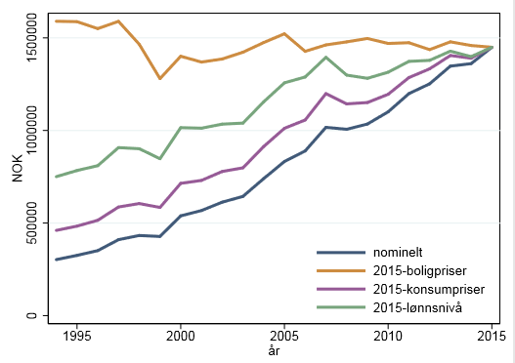
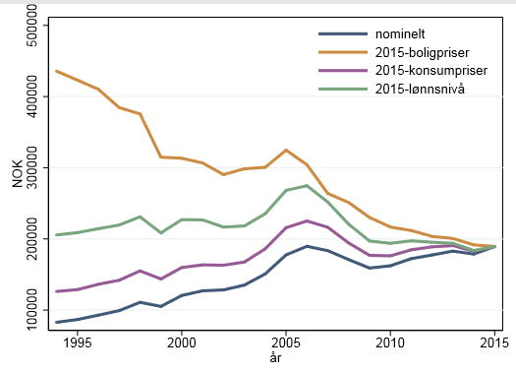
What does other evidence suggest?
Annual deflated debt growth for buyers. Only households that increase their debt
Annual deflated debt growth for stayers. Only households that increase their debt
House prices highly correlated with debt growth among buyers (extensive margin)
Wage growth highly correlated with debt growth for stayers (intensive margin)
Source: Forthcoming bankplassen blog post by Kjersti Torstensen

Slide 6
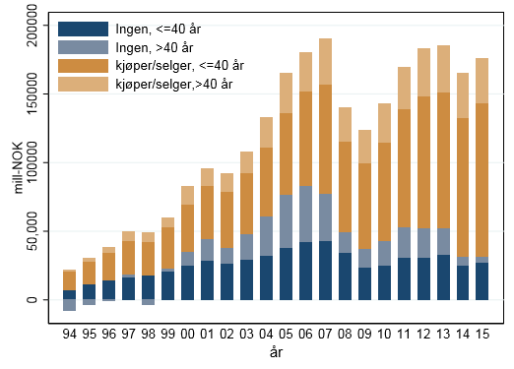
Debt growth for buyers/sellers and stayers
Debt growth is in many periods driven by younger people buying up in the housing ladder («wealthy hand-to-mouth»?)
(Source: Forthcoming bankplassen blog post by Kjersti Torstensen)

Slide 7

Theoretical framework / approach
Mason & Jayadev (2014):
  Historical decomposition of debt-to-income
  Can analyse the historical Fisher-effects in Norway (ex post), possibly using micro data to estimate new debt growth
Test/analyse the different channels more formally:
  Is the negative correlation between inflation and real debt growth causal?
  Fisher channel is more often associated with unexpected inflation.
  Is the cash-flow effect on debt growth ruled out too fast by looking at contemporaneous correlations?
  Adjustable vs fixed interest rate loans matters for Fisher effects?
  Annuity loan with adjustable rates creates an automatic link between interest rate and the rate at which you pay down the loan

