Slide 1

Discussion of paper by Karolina Ekholm:
“Pros and cons of taking part in the banking union”
NEPR conference on “Financial Regulation and Macroeconomic Stability"
Ministry of Finance, Helsinki, 12 December, 2019
Svend E. Hougaard Jensen, Ph.D.
Professor, ECON, CBS
Director, PeRCent, CBS
Chairman, Scientific Council, Bruegel
Member, The Systemic Risk Council

Slide 2
Structure
  Rationale
  Orders of magnitude
  EUNEZ, mind the gap…
  AOB

Slide 3
Rationale
Coordination failure
The academic literature has for long pointed to the need for a banking union when there is cross-border banking.
Papers include Folkerts-Landau and Garber (NBER, 1992); Schoenmaker (Kluwer, 1997); Vives (JFSR, 2001).
The ”trigger” is similar to the ”inconsistent quartet” in int’l finance: free trade, capital mobility, fixed/managed exchange rates, and monetary policy independence (Padoa-Schioppa, 1982)
Here’s a financial trilemma, stating that the three objectives of financial stability, cross-border banking and national financial polices cannot be achiéved at the same time (Schoenmaker, 2011)
More generally, the interests of home and host countries of cross-border banks are likely to deviate in distressed situations.
Interestingly, this point is listed by KE as a potential benefit of a banking union.

Slide 4
Rationale
Cross-border banking
Suppose country A is not only the home country of banks from country A but also host country of banks from country B.
In order to provide financial stability in country A, the authorities in country A would need information (about capital and liquidity positions of distressed banks) from the supervisory authorities of country B.
However, country B may have reasons to hold back such information.
Failure to get this information, fully and on time, might (seriously) jeopardize the possibility for country A to deliver financial stability in country A.
So, there’s a need for a supranational authority.

Slide 5
Rationale
Doom loop
The actual trigger for introducing banking union in 2012 was the perceived need to avoid that tax payers are stuck with the bill when banks are rescued…
KE refers to Farbi and Tirole (2018) as an academic contribution showing how the risk of a doom loop may create a rationale for centralized supervision.
The rationale for centralized supervision in this analysis arises partly because of cross-border externalities from sovereign default that are sufficiently large to justify transfers from foreign countries.
For MU members, the MU can be at stake…
For for small stand-alone countries the risk may be much smaller, as they aren’t constrained in the same way to act as LOLR vis-à-vis the government.

Slide 6
EUNEZ
Ins vs Outs
P3: “In this article, I am going to discuss the pros and cons of being a member of the banking union, mainly from the perspective of a country that is not obliged to participate because of its adoption of euro as its currency”.
Effectively, the focus of the paper is a study of whether it would pay for Sweden (and Denmark) to join the banking union…

Slide 7
Cross-border penetration of European banking
EU; % of total banking assets

Slide 8
Banking systems across three regions: BU, EU and US
End-2014

Slide 9
Cross-border banking penetration in non-euro area Member States
End-2014

Slide 10
Top 10 banks in non-Banking Union
2014

Slide 11
Mind the gap
SSM
Preparatory (SSB) vs. ultimately (ECB). This is an important discussion of the location of the supervisory authority.
So, EUNIZ has a problem here, by having NO representation on the ECB’s governing council…
DK has two decades of experience with taking part in such an arrangement, by being de facto in the EZ when it comes to MP but not being in the governing council…
KE advocates in favour of letting SSB decide. Or establishing SSM outside of the ECB. Right?
But: MP and FP are intertwined, as KE notes…
Is there as ”threshold” of cross-border banking: if above, EUNEZ should join BU…?

Slide 12
Mind the gap
SRM
How about BRRD (Bank Recovery and Resolution Directive) – which applies to all EU countries?
“In principle, the introduction of a common framework for bank resolution through BRRD should reduce the risk of inefficient outcomes regarding cross-border banks in financial distress.”
So, there may be a way out through BRRD – without joining the BU? How far is BRRD from producing outcomes similar to those of BU?

Slide 13
Mind the gap
SRM
If EUNEZ joins BU, it will have to transfer an amount of contributions to the SRF corresponding to what it would have transferred if it had participated in the SSM and SRM at the outset.
But if EUNEZ decides to leave, will the contributions transferred to the SRF be transferred back?
Has it been finally agreed to use the ESM as a backstop for SRF? And if EUNEZ joins BU, is the treatment the same as for EZ members?

Slide 14
Mind the gap
Why it’s difficult to persuade the Scandinavian EUNEZ
Clearest economic benefit of enlarging the banking union is the prospects of more efficient resolution of cross-border banks.
But how are the gains distributed?
Cherry picking countries (DK; SE)
Could “flexible” membership be considered (“LIFO?)

Slide 15
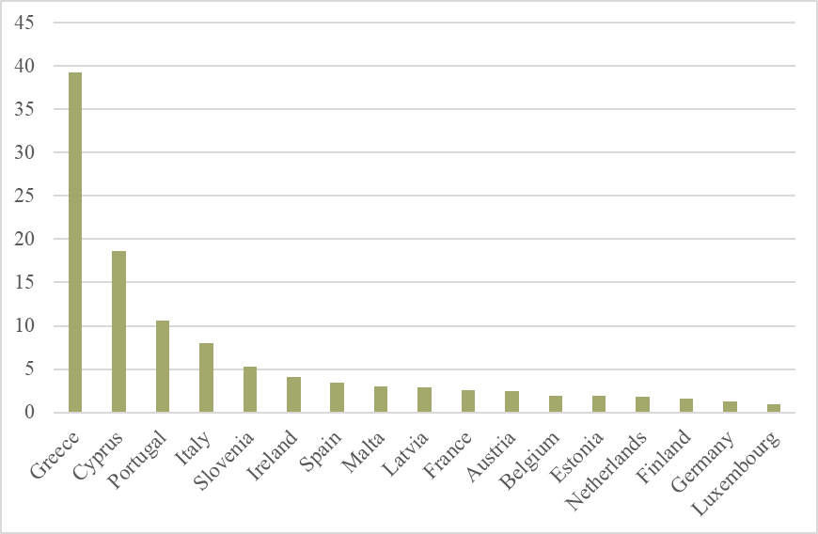
Non-performing loans ratios (%) in the banking union
Q2 2019

Slide 16
Mind the gap
SSM
“Clearest cost is the loss of regulatory and supervisory independence”. However, the size of that cost may be small in a world where financial markets are highly integrated.” Well, should perhaps be counted as a benefit.
“The SSM has significant resources and will over time gain extensive experience in supervising different types of institutions (Beck, 2019). The fact that it is located far from most of the institutions that it supervises may also reduce the risk of regulatory capture.”
To me, this may be a key benefit of joining the BU – perhaps the most important one!
The SSM, based in the ECB, would be able to not only attract talent and develop seniority, having a team of very experienced, highly professional and well-paid staff.
FSAs in smaller EUNEZs typically have high turnover rates, with the best and most ambitious staff moving to the private financial sector.
But supervision is complex, and make heavy demands on skills to match the expertise available in commercial banks etc.

