Slide 1
Industrial Circular economy in Kemi-Tornio region & the National Industrial Circular Economy Programme
Digipolis – CE Centre Kari Poikela
Study Tour Lapland
Kemi 13.6.2018

Slide 2
Digipolis- Kemi Technology Park: Development company and cluster organisation
  Digipolis Kemi, established in 1993
  Owned by the cities of Kemi & Tornio,
  the University of Oulu and municipalities of Simo, Keminmaa and Tervola
  50 companies, 500 employees in the technology park – network of more than 160
  industrial service businesses in Lapland, more elsewhere
  Development actions and services:
    Team of 14 persons + service providers
    Innovative environment especially for industrial service businesses
    New openings: 2008-2016 Expertise on Arctic conditions & Industry,
    novel wood constructions: CLT development platform
    2012- Ecosystem of the Arctic Industry - Innovation Platform
    2014- Arctic Industry and Circular Economy Cluster management
    2016- Digipolis chosen as key actor in national circular economy
    roadmap and implementation of the key project activities
    2017- Establishment of Centre for industrial circular economy
    Start-Up, Business Incubation, Business Growth, Invest In services
    21 ongoing development projects, 584 companies and organisations

Slide 3
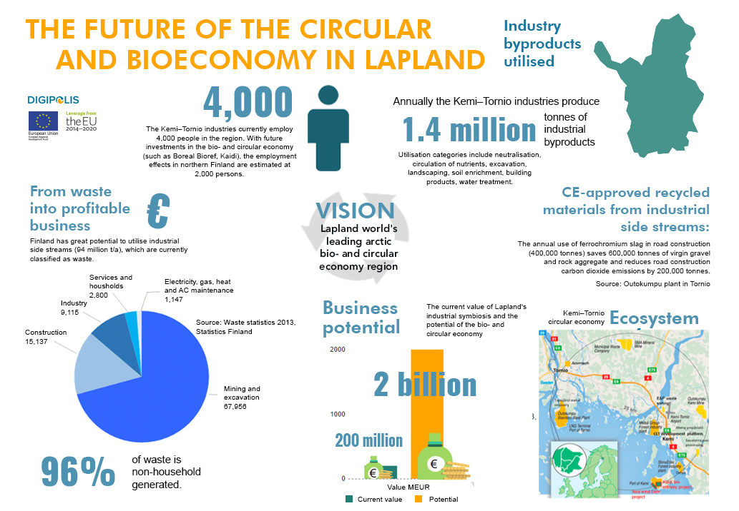
1 . 7 m i l l i o n
700 million

Slide 4
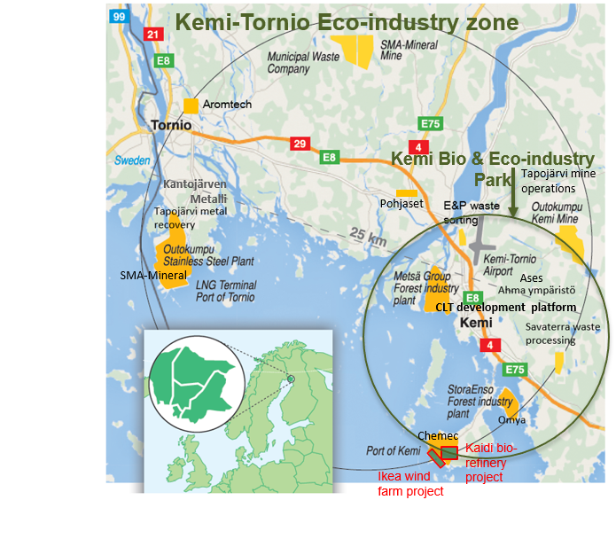
ECOSYSTEM OF ARCTIC INDUSTRY
Kemi-Tornio`s circular economy innovation platform
Worlds northernmost hub of bio-, mining-, metal industry and services
1,7 Mt of by-products and residues (excluding waste rock)
Responsible for 80% of Lapland’s industrial production, with over 5 billion EUR of exports annually (7-8 % of the total export value of Finland)
Industrial symbiosis estimated at 700 million EUR annually

Slide 5





MAIN INDUSTRY SITES IN KEMI-TORNIO REGION
  Metsä Board and Metsä Fibre Kemi mills
  World’s northernmost linerboard production site
  World’s northernmost pulp mill
  Outokumpu Chrome Kemi mine
  Europe’s biggest chromium mine
  Outokumpu Tornio stainless steel mill and ferrochrome smelter
  Outokumpu's site in Tornio is the most integrated stainless steel mill in the world
  Europe’s biggest user of recycled steel
  Stora Enso Veitsiluoto Mill in Kemi
  World’s 2nd northernmost pulp mill
  World's northernmost paper producer with three paper machines
  Oldest sawmill in production in Northern Finland
  Manga LNG liquid natural gas terminal in Tornio 2018

Slide 6
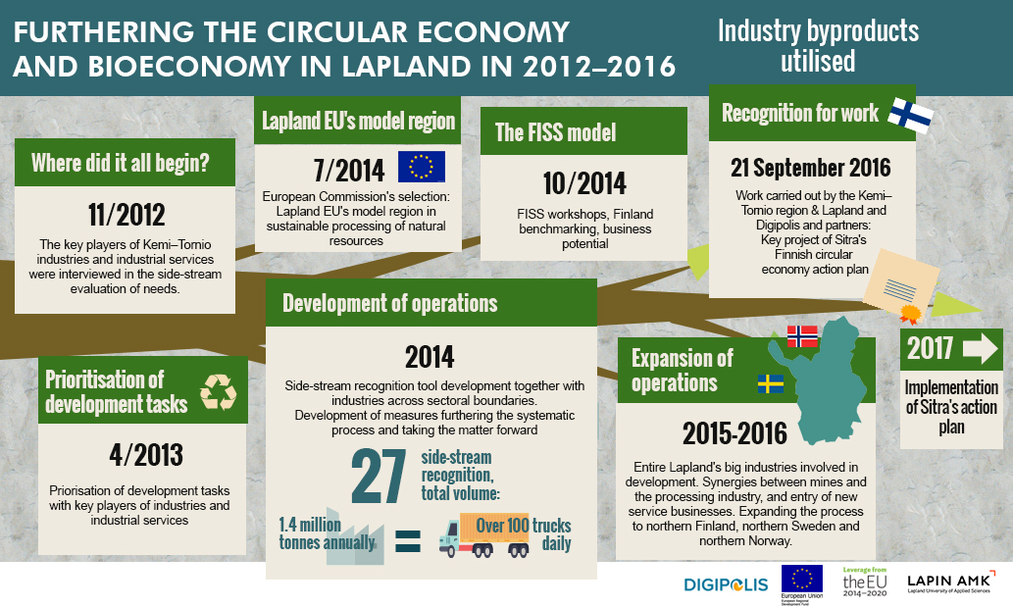

Slide 7
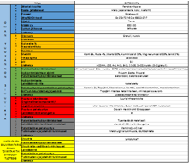
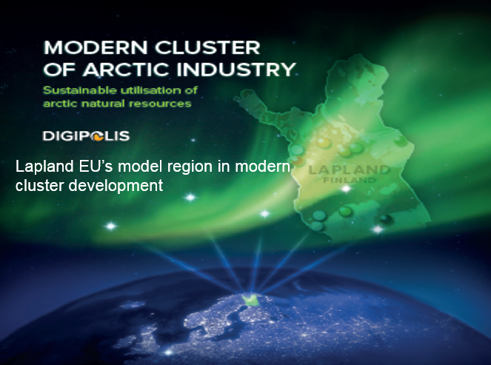
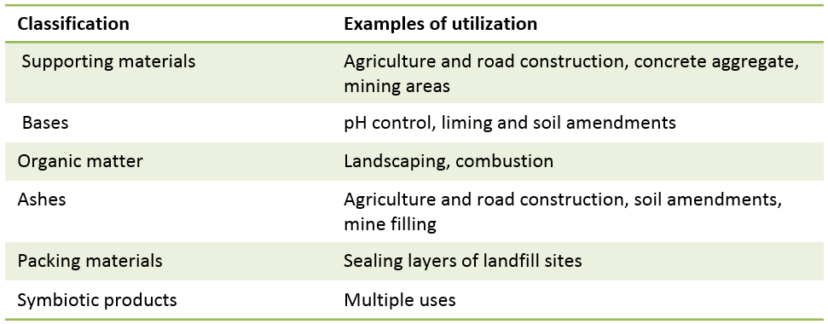
1 700 000 t of Industrial by-products
Identification
Characterisation
Recognition
Classification

Slide 8
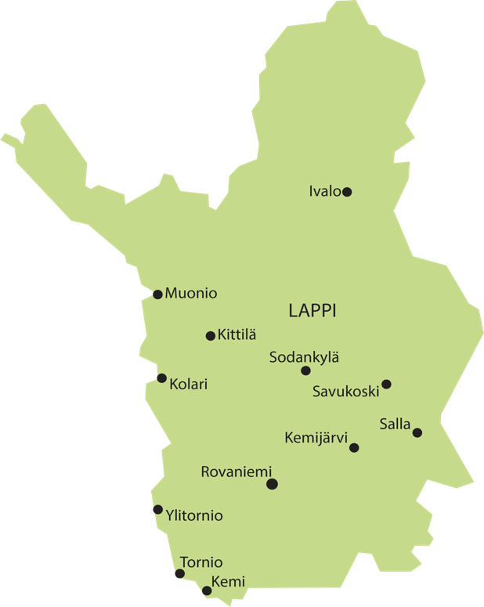









Utilisation of the arctic natural resources
– Lapland's Arctic Industry
Arctic Spring, Investment boom in Arctic regions
Industrial- and mining service companies receive orders worth of hundreds of millions.
International-industry standards, HSEQ
Cleantech – growing need of sustainable solutions
Enhancing Circular Economy
Internationalization in home
market, glocalization
Internationalization in the
surrounding countries
Own products and services
Production sites
Under construction
Planned investments
World class exploration
projects

Slide 9
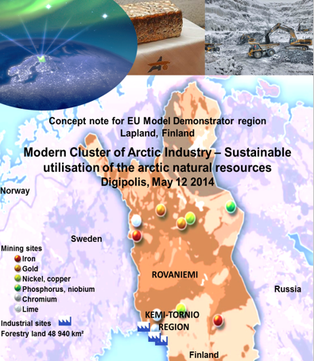
ARCTIC BUSINESS CONCEPT ABC
Modern Cluster of Arctic industry –
Sustainable utilisation of the arctic natural resources
Model region to demonstrate EC new wave cluster policy:
The region possesses the vast deposits of natural resources and pristine nature
Lapland has potential to become one of the leading regions in the world in the sustainable exploitation of natural resources
The region should focus on refining of Arctic natural resources in a socially and ecologically sustainable manner, combined with high value added generation from natural resources in the region
Focus on to maintain the balance in the sustainable development

Slide 10













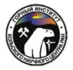
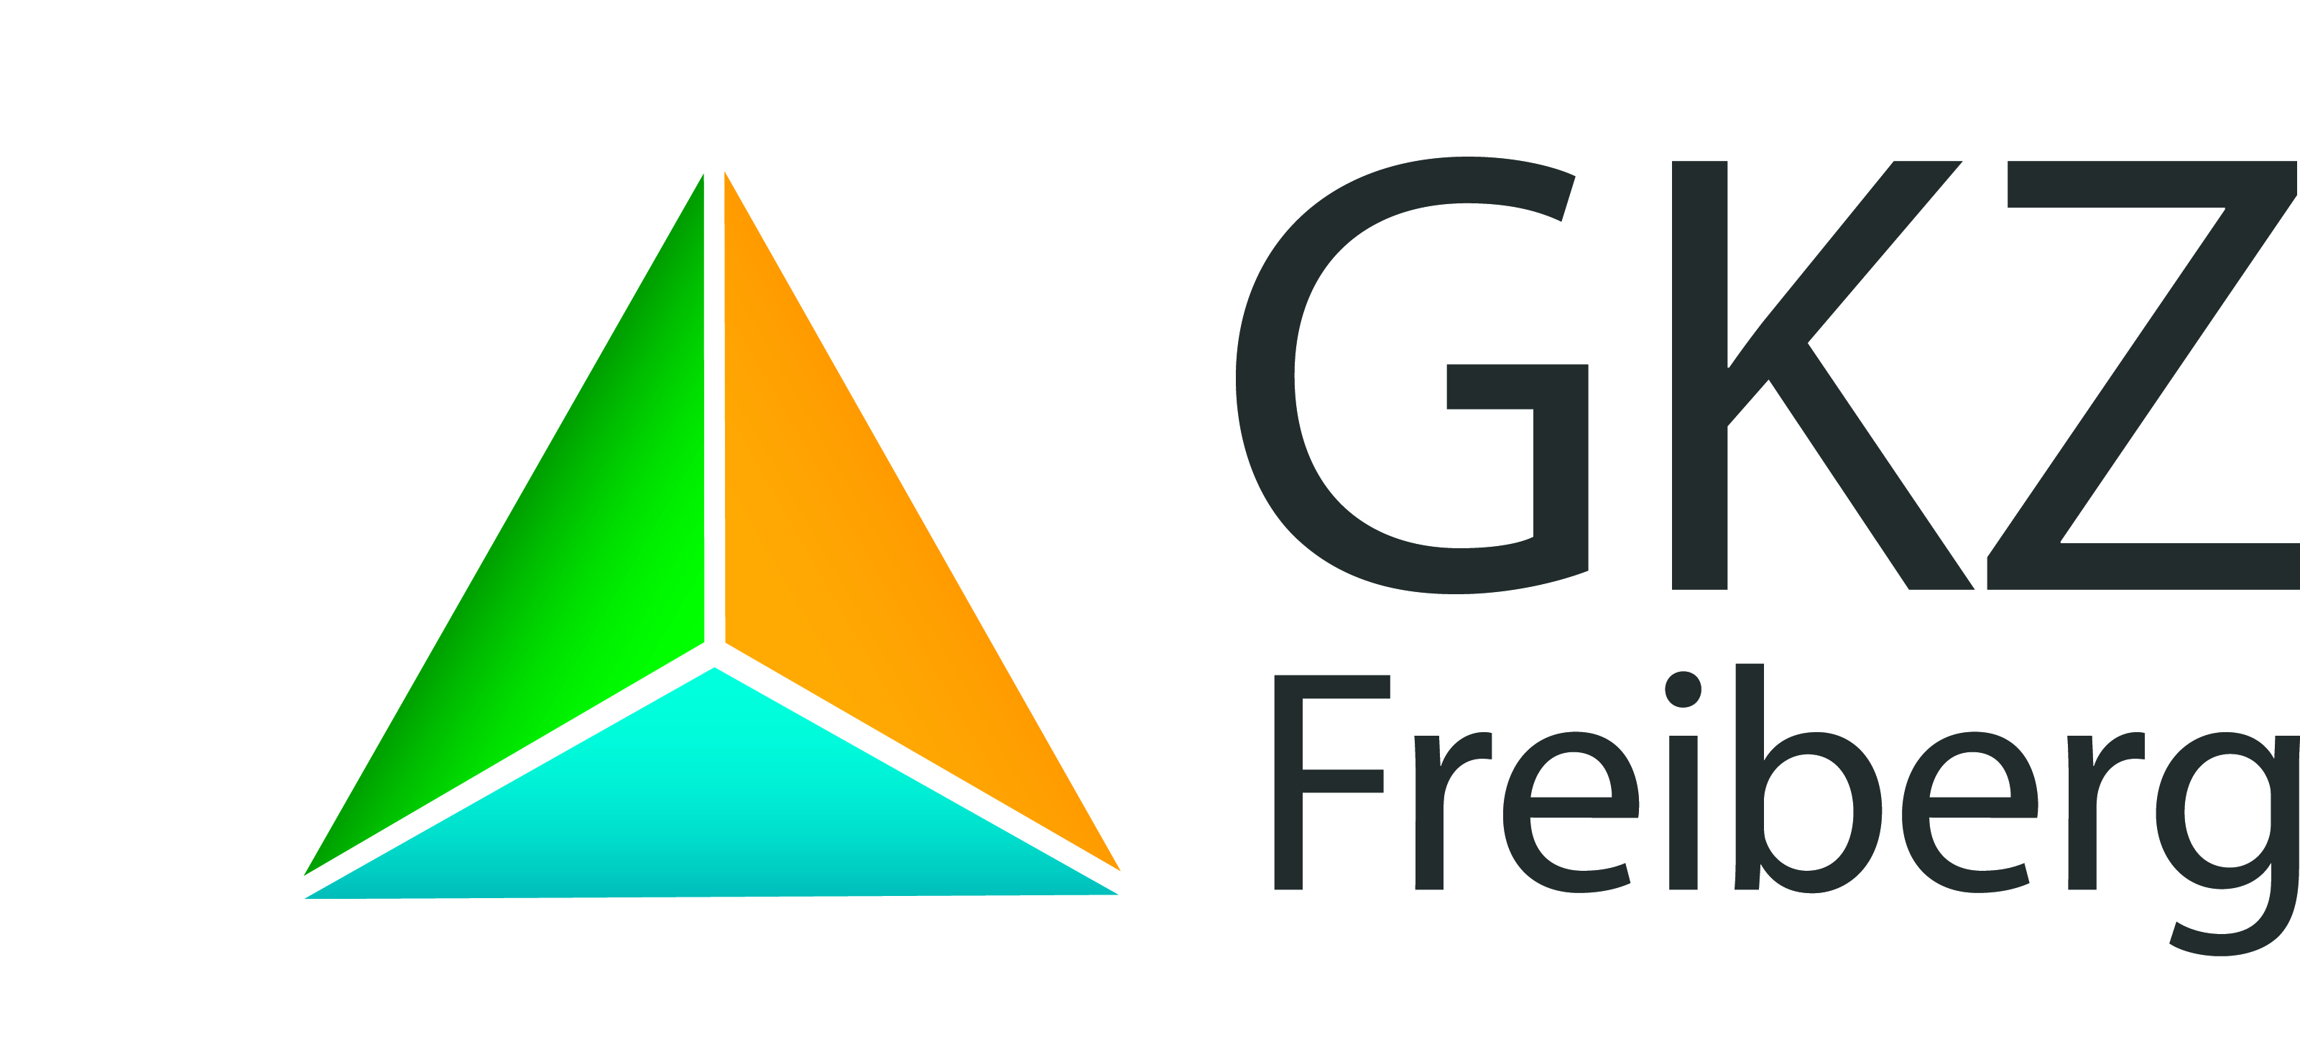


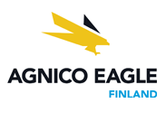
















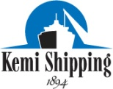



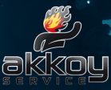


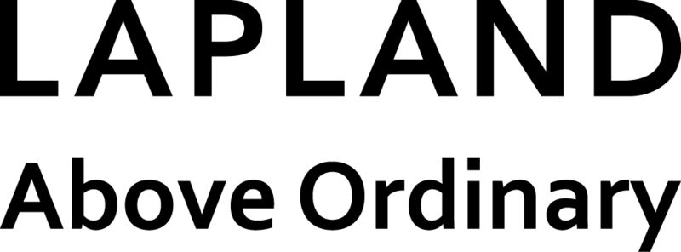








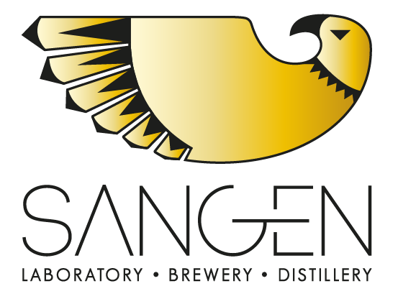






























Arctic
Industry &
Circular Economy
Cluster
Sustainable exploitation of arctic natural resources
Notes:
If You would like to join our clusters’ upper rigt box as a business partner outside Lapland, please contact me or my Lappish colleagues.

Slide 11
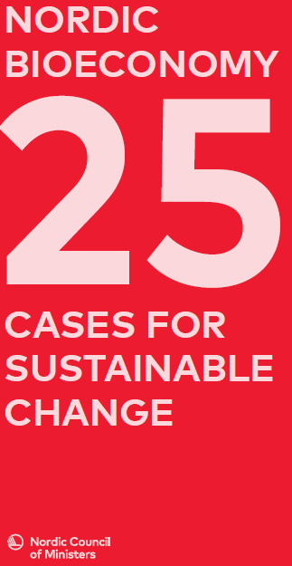
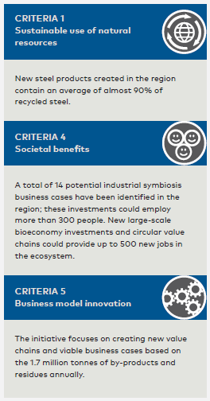
NORDIC COUNCIL OF MINISTERS’ SUSTAINABLE NORDIC BIOECONOMY CASE IN CIRCULATE CATEGORY
The Kemi-Tornio region in northern Finland has established an Arctic industry and circular economy cluster to enhance industrial symbiosis and strengthen the development of a holistic bioeconomy in the region. Via extensive analysis of the by-products and residue streams from companies in the region, value-added products are now being produced by combining and rethinking several by-product and residue streams. Examples include silvicultural thinning practices, bioenergy from forest residues with the possibility for future for largescale biofuel production, as well as two plants that enable recovery of metals from slags from the steel and ferrochrome production in the region.
Notes:
Arctic Industry and Circular Economy Cluster is based on two main issues which are available in Lapland: primary raw materials and secondary raw materials generated mainly by process industry in Kemi-Tornio region in Southern-Lapland.

Slide 12
Circular economy can be boosted through long-term systemic changes, quick experiments, scalable solutions, and stimulation of demand
CE in public
procurement
Cooperation with European Climate Foundation – CE as a means for mitigating climate change
The creation of indicators for Finnish road map to a CE
WCEF 2017 – World’s first global CE forum
Policy actions
for creating
functional
domestic market
Large and small
projects, and
sharing
best practices
A list of the most interesting CE actions in municipalities
Financing for revolutionizing transport in regions
A list of the
most interesting companies in the CE in Finland
Finnish industrial
CE Centre in Kemi
Regional sustainable food system
CE to become a part of education and future decision-making: CE in study programs of schools and universities
CE demonstration plant
for recycling valuable metals of waste electrical and electronic equipment
Notes:
Lisätietoa hankkeista:
Kestävä alueellinen ruokajärjestelmä
https://www.sitra.fi/hankkeet/alueellinen-kestava-ruokajarjestelma/
http://mmm.fi/artikkeli/-/asset_publisher/kestavan-ruokajarjestelman-pilottimallin-kehittaja-on-valittu
Liikkumisen kehitysohjelma & rahoitushaku tulossa
https://www.sitra.fi/blogit/uskaltaisiko-maakunta-mullistaa-liikkumisen/
Kiertotalouskoulutus
https://www.sitra.fi/en/projects/circular-economy-teaching-levels-education/
A list of the most interesting companies in Finland
https://www.sitra.fi/en/projects/interesting-companies-circular-economy-finland/
Finnish industrial centre in Kemi
http://www.digipolis.fi/en/home/news/finnish-industrial-circular-economy-centre-to-be-established-in-kemi.html

Slide 13


Kemi CE Centre Advisory Board
Eija Virtasalo, Head of Financial Unit, Centre for Economic Development, Transport and the Environment
Eira Luokkanen, Head of Unit – Environmental Protection, Centre for Economic Development, Transport and the Environment
Jyri Seppälä, Director – Centre for Sustainable Consumption and Production, Finnish Environment Institute (SYKE)
Eero Yrjö-Koskinen, Secretary General, Finnish Network for Sustainable Mining and Director, Green Budget Europe
Riikka Aaltonen, Senior Adviser – Mineral Policy, Enterprise and Innovation Department, Ministry of Economic Affairs and Employment
Kari Herlevi, Project Manager – Circular Economy, Sitra
Nani Pajunen, Leading Specialist – Circular Economy, Sitra
Olli Dahl, Professor, Aalto University, Clean technologies research group
Riitta Rissanen, Managing Director, Lapland University of Applied Sciences
Tero Nissinen, Chair, Mayor, City of Kemi
Martti Sassi, Senior Vice President – Head of Operations, Outokumpu Tornio Works
Juha Mäkimattila, Mill Director, Stora Enso Veitsiluoto Mill
Kari Ala-Kaila, Vice President – Technology , Metsä Fibre
Mikko Korteniemi, General Manager, Agnico Eagle Finland Kittilä Mine
Jukka Jokela, General Manager/Project Manager, Anglo American - Finland AA Sakatti Mining
Jari Hietala, National Division Leader, Eurofins Environment Testing
Juha Koskinen, R&D Manager, Tapojärvi Oy/ Hannukainen Mining Oy
Tuula Sivonen, ‎Regional Manager, The Federation of Finnish Technology Industries
Kimmo Heikka, Managing Director, Kemin Digipolis Oy
Heino Vasara, Sector Manager, Centre for Economic Development, Transport and the Environment

Slide 14
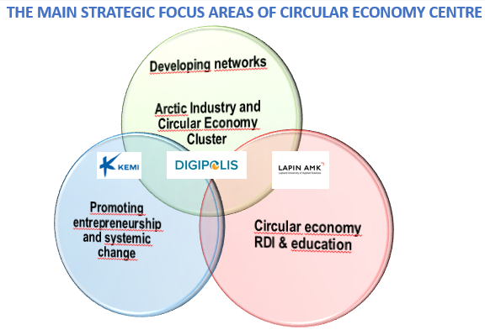
Finnish industrial circular economy centre - established in Kemi in 2017
In partnership with the Finnish Innovation Fund Sitra, City of Kemi, Digipolis – Kemi Technology Park and Lapland University of Applied Sciences
First industrial circular economy centre in Finland with national level mandate
Network of industry &university experts and intermediaries
International network including e.g. Nordic and Chinese cooperation partners
National level goals: competence building in industrial circular economy, spreading the operating models of the Kemi industrial circular economy in Finland
Regional/local level goals: new investments and jobs, contribution to sustainable and resource efficient industry modernization, cooperation culture

Slide 15
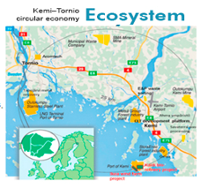

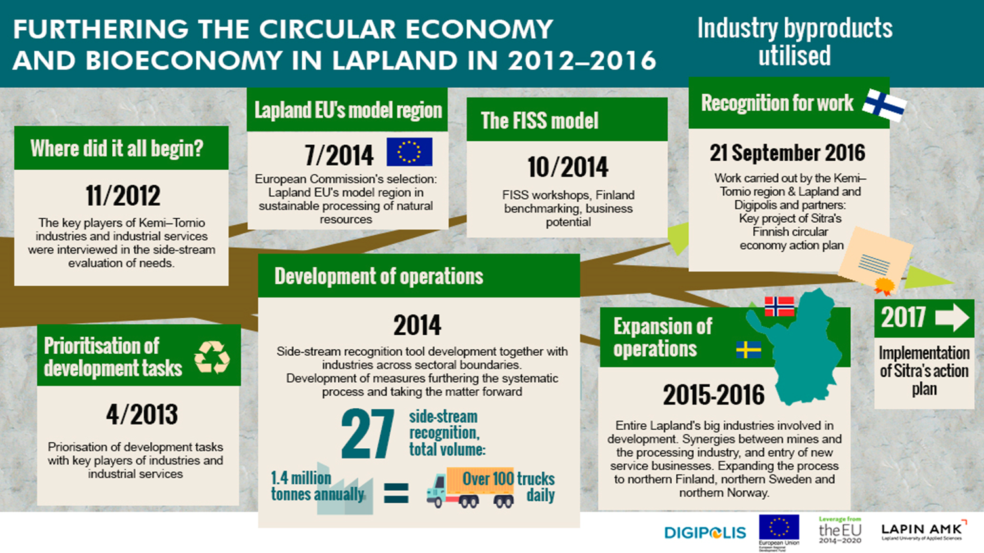
OPERATIONAL MODEL FOR REGIONAL/LOCAL
INDUSTRIAL CIRCULAR ECONOMY PLATFORMS
Description of the operational model for local/regional industrial circular economy platforms, largely based on the experiences of the Kemi-Tornio in 2012-2017
Eight major pillars - to be regionally/locally adapted taking into account the local industrial background and features

Slide 16
DESCRIPTION OF OPERATIONAL MODEL: EIGHT PILLARS
Identification of the needs of companies considering industrial symbiosis activities
Gathering of stakeholder network: companies, R&D organizations, public authorities
Concrete start-up activities: industrial pilots & public-private initiatives
Toolbox of Industrial Symbiosis: information on possibilities (know-what), instructions on practical utilization (know-how), information sources (know-who)
Communication on the possibilities, first success stories and events of industrial circular economy
Trust building, including e.g. practices and instructions regarding dissemination of industrial symbiosis information
Benchmarking &networking : regionally, nationally, and internationally
8 Priority in the needs and possibilities of the participating companies

Slide 17

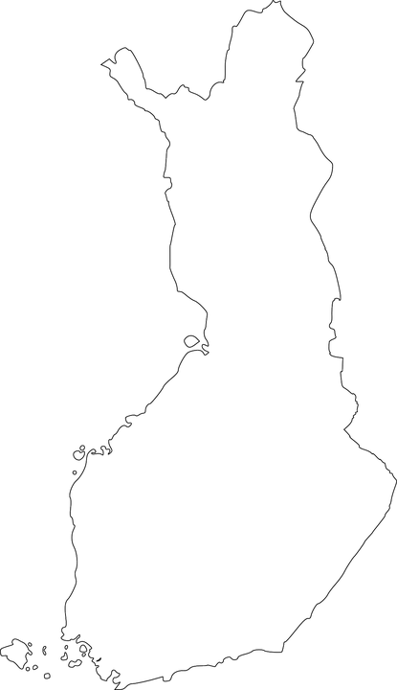







Network of eco-industry parks in Finland
Kemi
Kokkola
Kemijärvi
Pori
Nokia
Forssa
Forssa
Riihimäki
Riihimäki
Turku
Porvoo
Salo

Slide 18
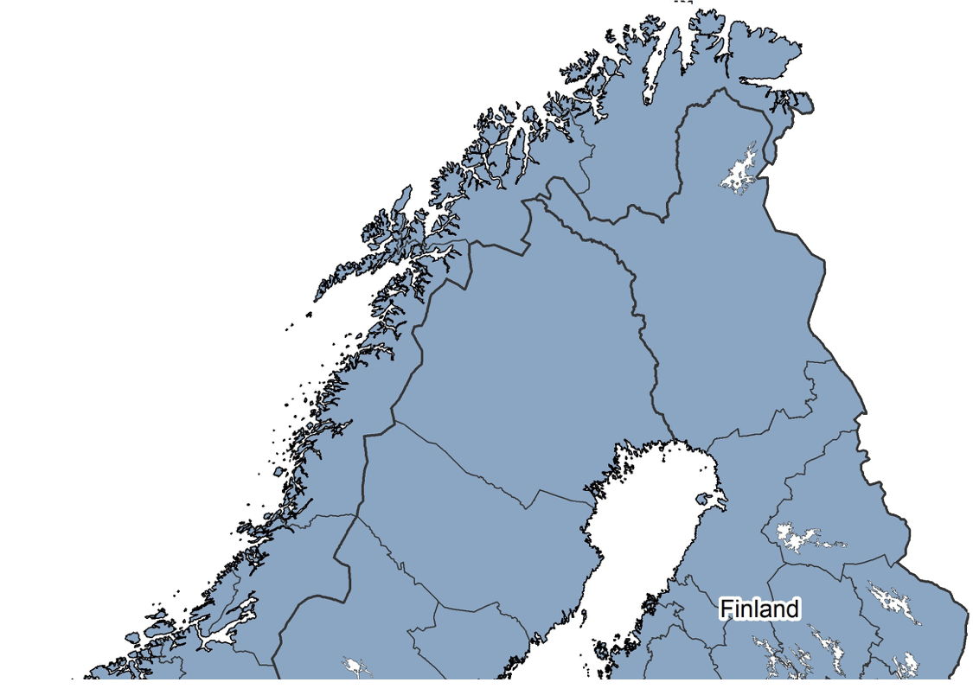


Nordic Industries
Story of Natural Resources Refining
Global Markets
Good Connections
Arctic Solutions
Cleantech Solutions
5 Bio Refineries
32 Sawmills
16 Mines
5 Metal Refineries
2 Aluminium Smelters
1 LNG Refinery
2 Chemical Plants
Oil and Gas
Mining
Bio- and Metal Industries
Kemi-
Tornio
200 km

Slide 19
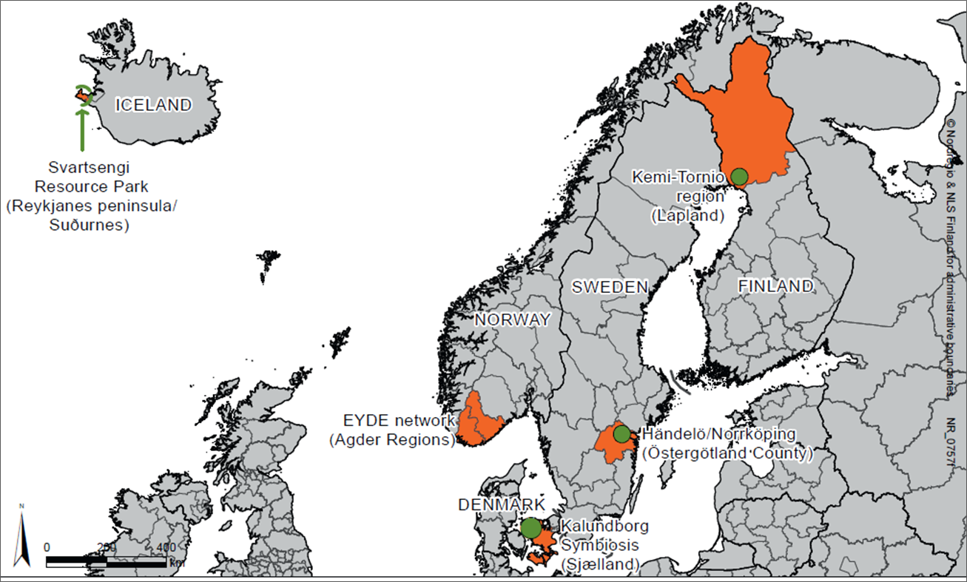
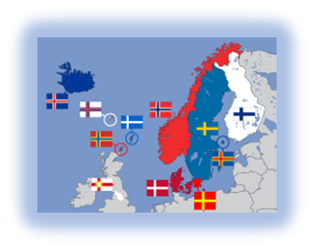

Nordic Industrial Symbiosis
Network
A forum/club to promote joint Nordic
initiatives in the field of Industrial Symbiosis
Creating a Nordic network of Industrial Symbiosis actors
Core partners at the start-up phase: Kalundborg (DK), Kemi-Tornio (FI), University of Linköping (SE), EYDE Cluster (NO). Nordregio, and Nordic Council of Ministers actively promoting the starting phase
Introduction at the World Circular Economy Forum, Helsinki in 2017
Not a closed club; new partners invited to join the network. New partners 2017-2018 include Paper Province, Värmland (SE) and ECO3, Nokia/Tampere (FI)

Slide 20
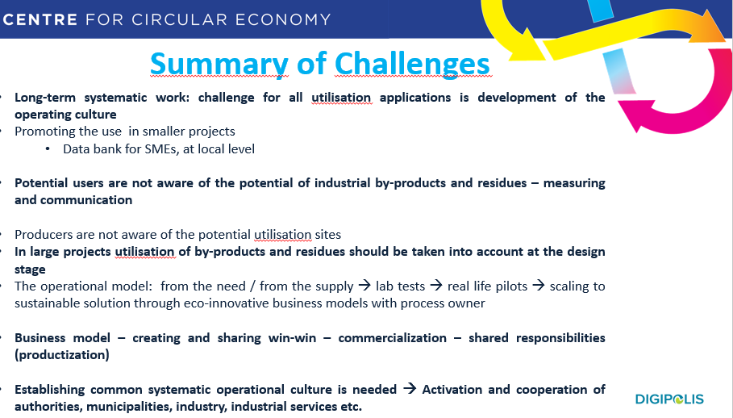
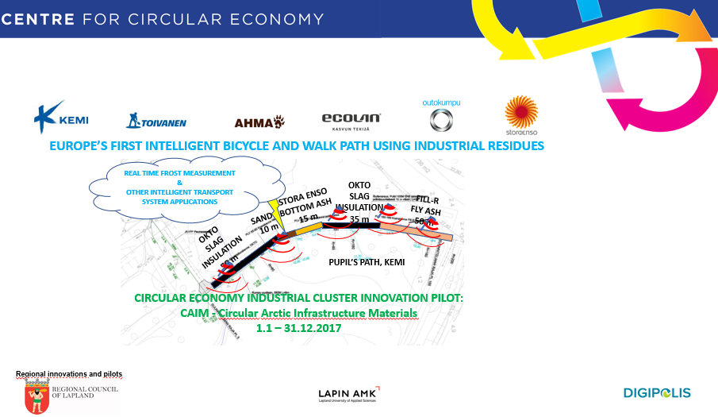
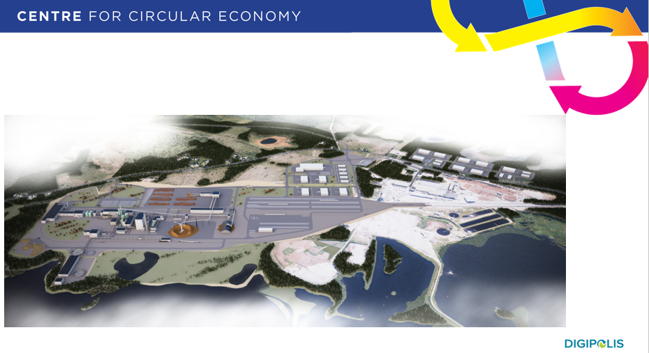
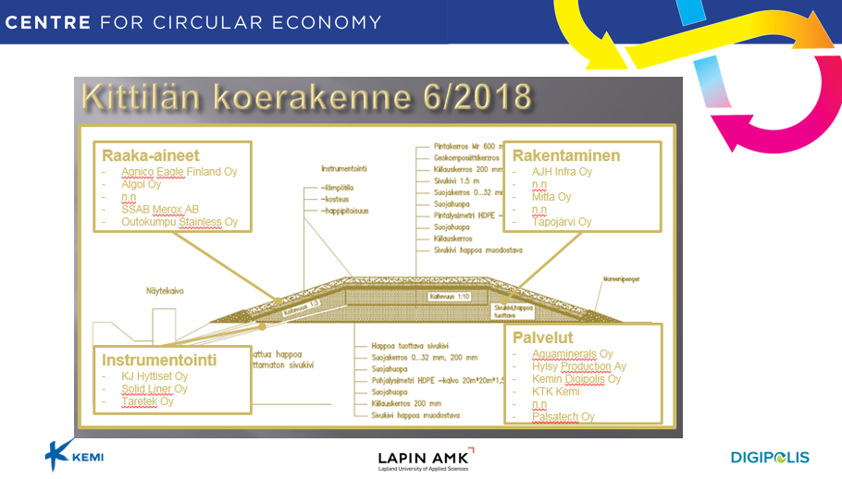
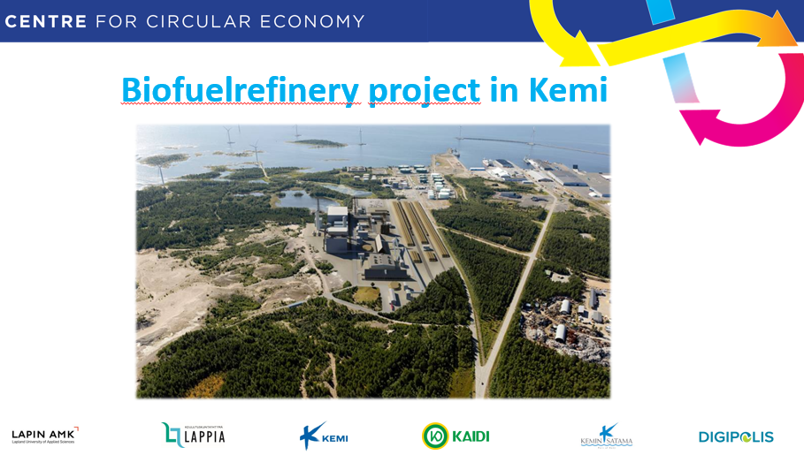
Case examples

Slide 21
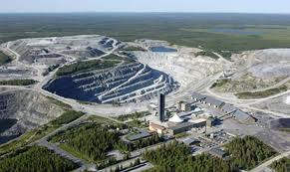
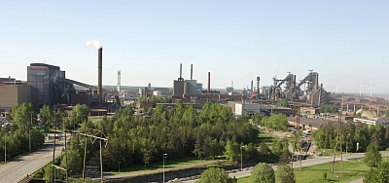
Sustainability Assessment Tool (SAT)
Sustainability of the mills means assessment of environmental, economical and social issues with legal aspects using proper metrics. It also covers Regional Economic Dimension (RED)
The purpose was to develop a “simple” tool for evaluation the sustainability of process industry
(Images: http://www.goodnewsfinland.com/archive/themes/mining-industry-2/eco-efficiency-in-mining-courtesy-of-finland/, 19.11.2012,
http://www.energy-enviro.fi/index.php?PAGE=2906&NODE_ID=2906&ArchiveId=319&ArchiveSelect=200607, 19.11.2012.)

Slide 22
  Interested in to do co-operation?
  Contact: kari.poikela@digipolis.fi
  Please visit: www.teollinenkiertotalous.fi
Thank You!
Kari Poikela
Projektijohtaja, Teollinen kiertotalous
Project Director, Industrial Circular Economy
Tietokatu 6
94600 KEMI
mob. +358 50 435 8283
kari.poikela@digipolis.fi

