Slide 1
Social
Presentations:
Linda Gustafsson from Umeå municipality
Lisa Berg from Fenomenalen, Region Gotland
Moderator: Johanna Feuk Westhoff, Nordregio
Rapporteur: Sara Gustafsson, Linköping University
What is your experience in working with gender in relation to the SDGs and the 2030 Agenda? (experience in using gender budgeting in spatial planning).
How do you work SDG 16?

Slide 2
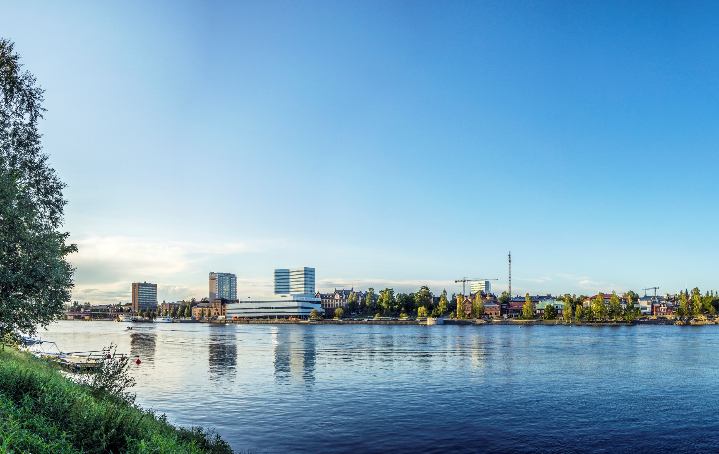
The gendered landscape of Umeå
Linda Gustafsson, gender equality officer
linda.gustafsson@umea.se
www.umea.se/jamstalldhet
genderedlandscape.umea.se
Notes:
Today’s presentation
Gender equality politics in Sweden and Umeå and organization of gender equality work in Umeå
Examples from Umeå of how we put this into practice and work with gender equality

Slide 3
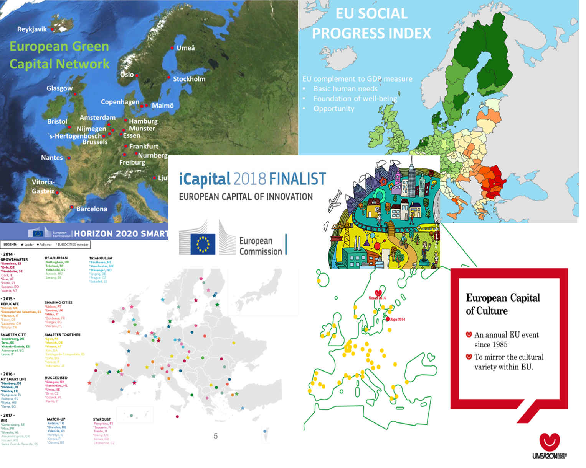
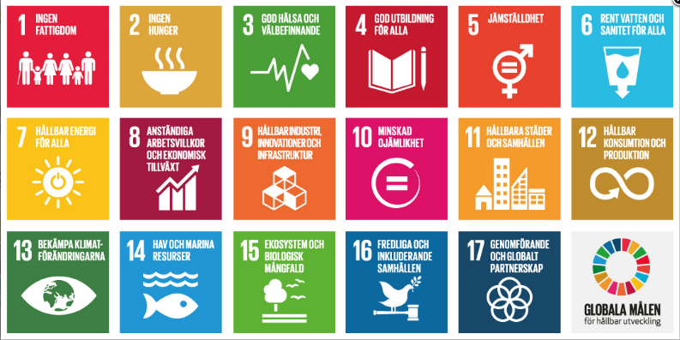

Slide 4
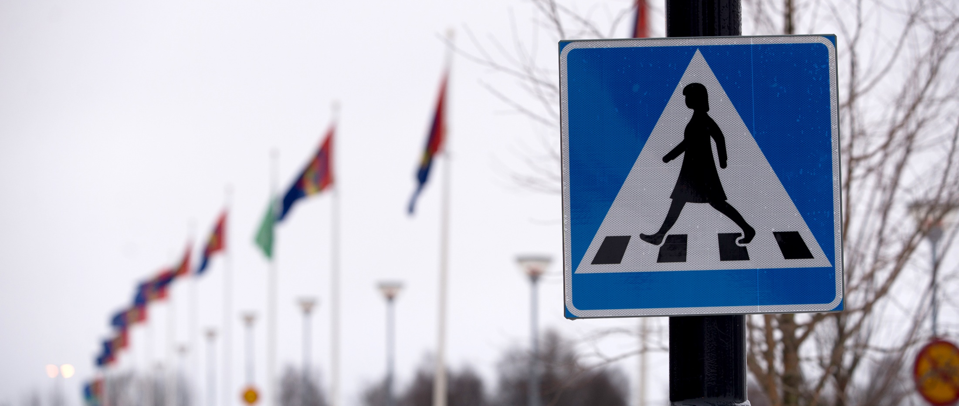
Create conditions for women and men to have equal power to shape society and their own lives.
Overall goal for gender equality,
of Umeå:
Notes:
Umeå has for a long time had a goal on gender equality. It is an overarching goal, which means that all of the different branches of the municipality have to work towards this goal within the framework of their specific area of work., having activities aiming at fulfulling the goal.
This means the streets and park department, detailed planning, building permits and so on, all need to integrate the gender equality goal into the work of their department.
There is also a specific political gender equality commitee connected to the city council, making sure for example that all decisions made by the city council have a gender equality analysis as a basis of the decisions.
To have this political mandate is very important for the long time work on gender equality, because it is not a quick fix, it is something that we need to work with continousluy.
One thing I also want to highlight about the goal is that it is about power. That is, the goal is not to have equal number of men and women in all areas. Of course power can mean representation, but not only representation.

Slide 5
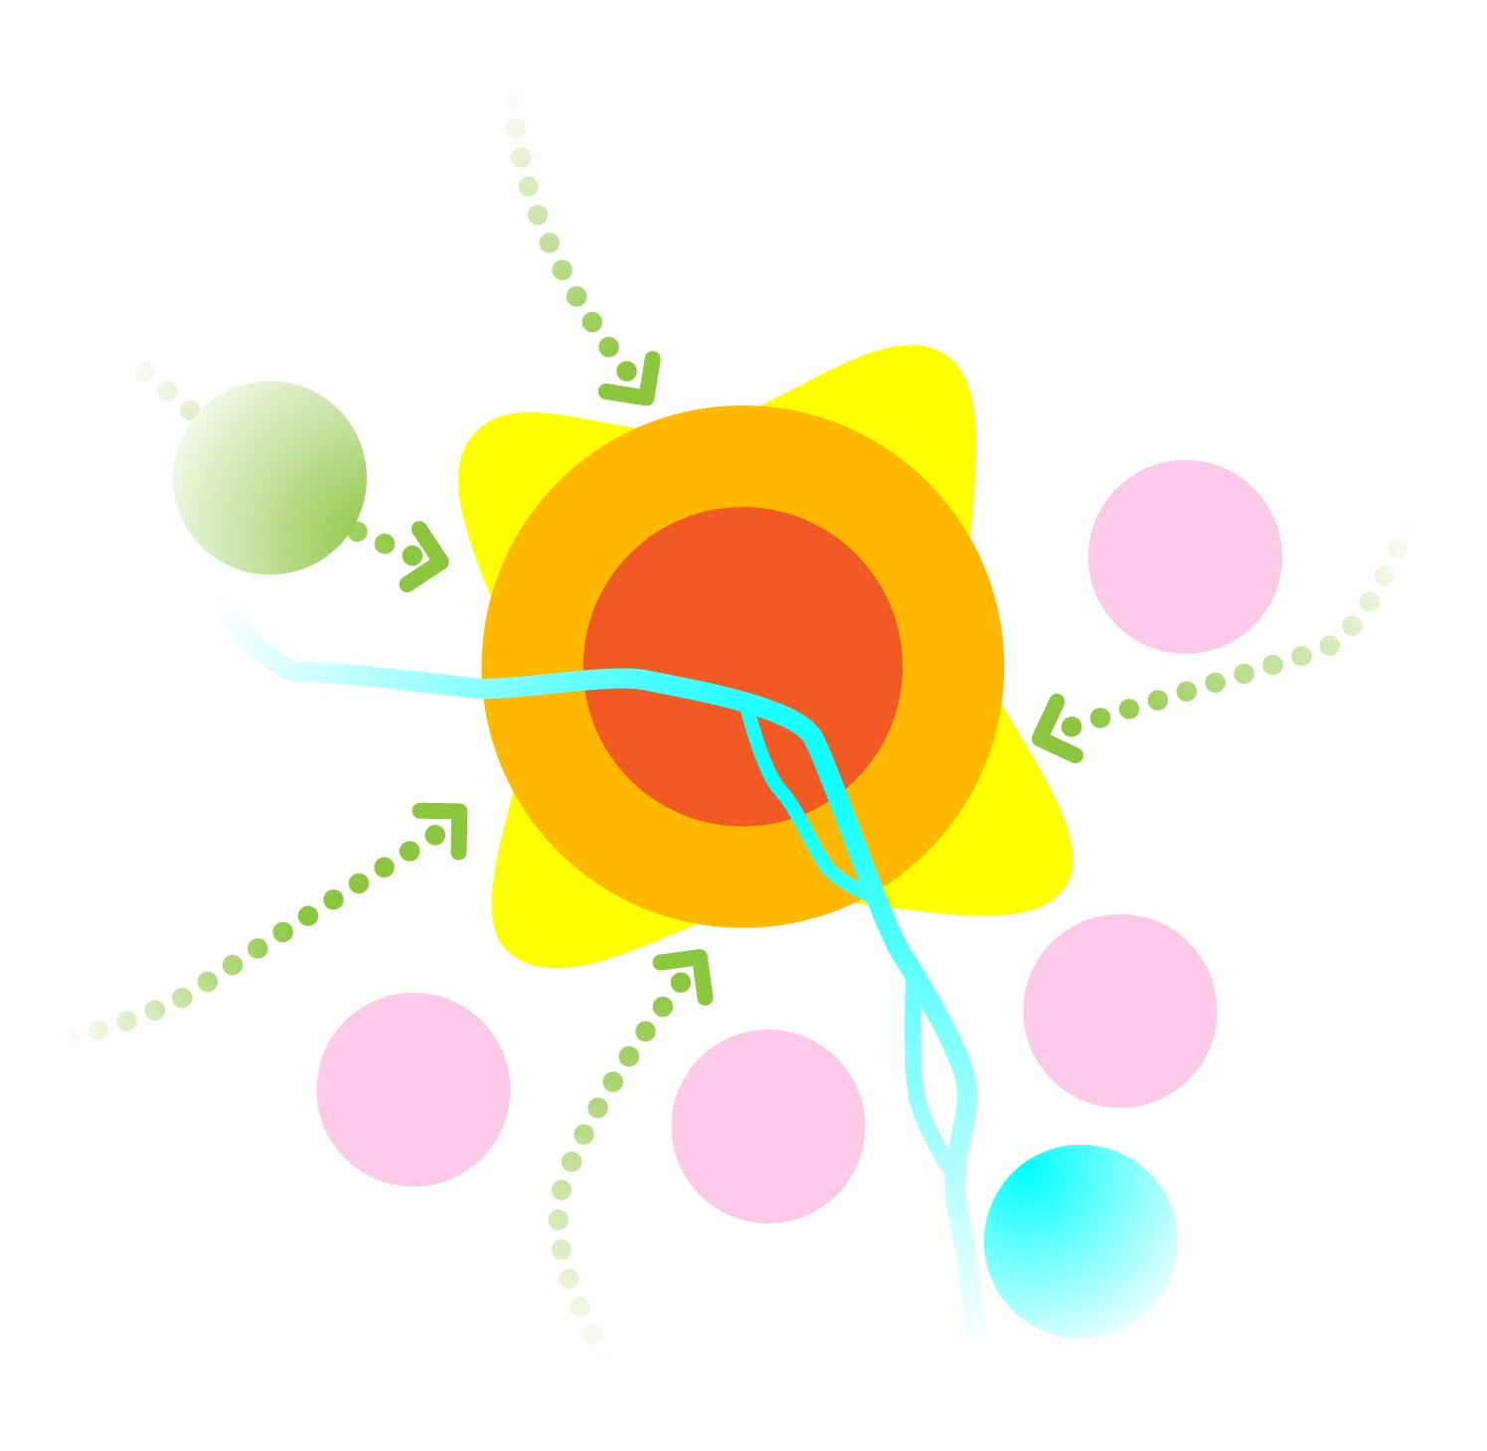
A city with high accessibility without being traffic intensive
A competitive public transport system requires a dense structure
A CITY WITH HIGH DENSITY
–
A STRATEGY TOWARDS
200 000 INHABITANTS
The city as meeting place and driving force for strengthen identity
Invest in parks and public spaces
Transparency, democracy and equality
- Co creation process
Building a city with high urban qualities
Linking neighborhoods together and create variety by mixed use
Notes:
Going into how we work with gender equality in practice, i will focus on how we integrate this in planning.
These are the strategies for growth in the comprehensive plan of Umeå. Umeå is a city of 127 000 inhabitants, and grows with about 1500 people per year. Umeå is a university town, and with an average age of 38 years.
HÄR KOMMER ANIMERINGEN (TRYCK FRAM RINGEN): In the strategies for growth, you can see that transparency, democracy and equality is part of that. In the strategiy documents it says explicitly that gender equality is to be part of the planning process.
This is because we believe firmly that:
A sustainable city can only be built together with those who will live in it. All planning should be permeated by openness, democracy and equality. We will develop the city and the public space so that everyone, women and men, children, young people and people with disability, can participate on equal terms. That leads to a city for everyone.
In order to reach our overall goal for gender equality it must be an integral part of this

Slide 6
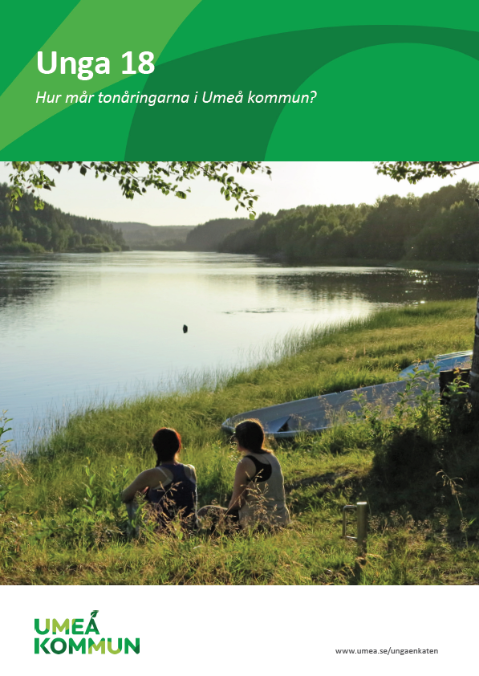
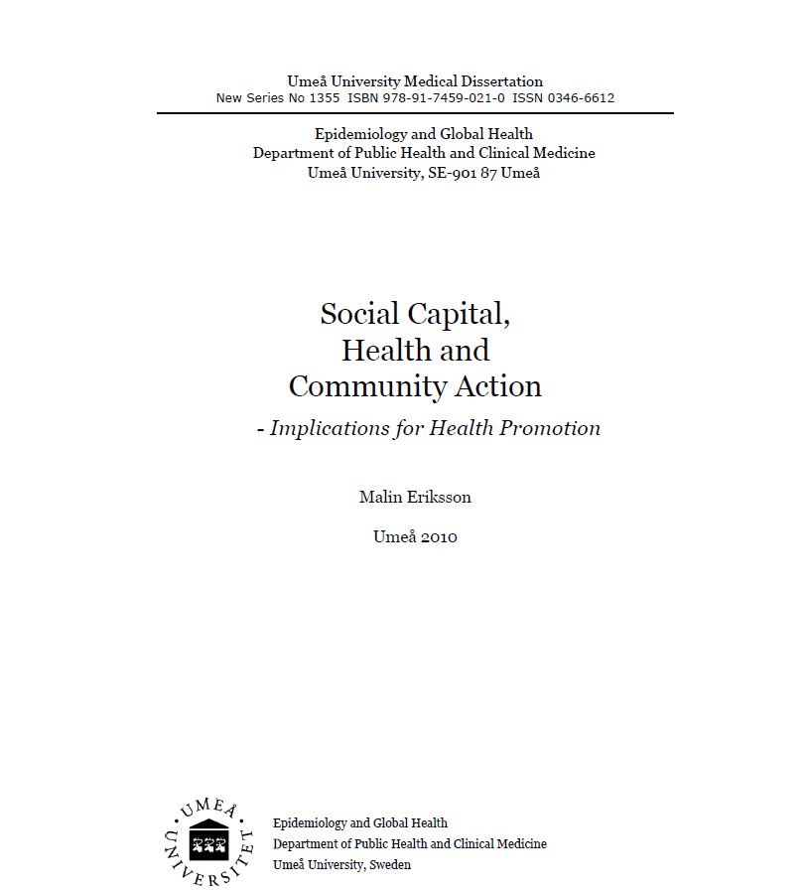
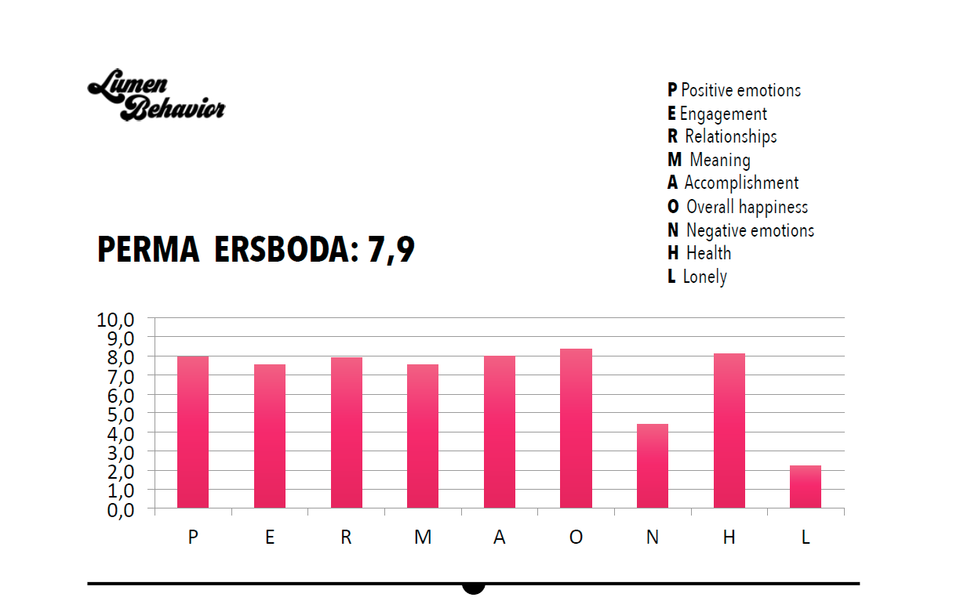
Commission on social sustainability
Trust and wellbeeing
Conditions of upbringing
The built environment
Work and livelihood
Notes:
We would like to invite you to speak at one of the parallel sessions, specifically the one on “How to get started” with a special focus on how you integrate gender budgetting in spatial planning, and why you focus on health and wellbeing to implement the 2030 Agenda

Slide 7
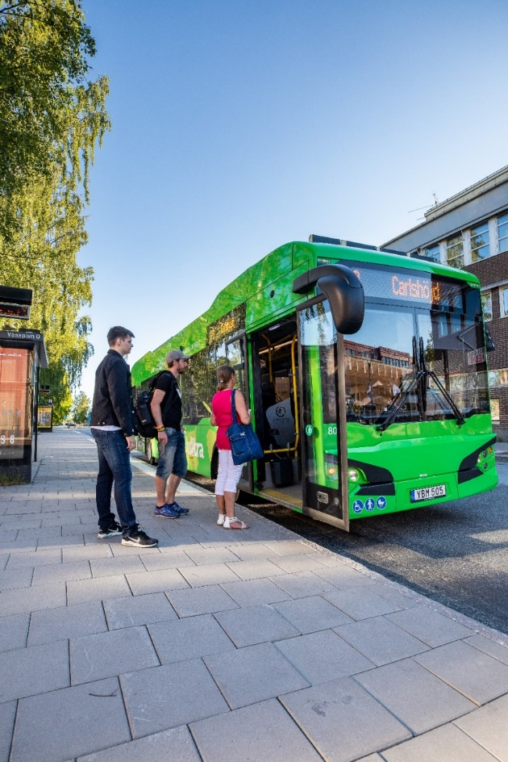
Surveys sustainabilty and gender equality
Travel habit survey – planning mobility and infrastructure
56% womens travel sustainable
42% mens travel sustainable
More efficient to electrify buses or get men to take the bus?
Notes:
And how is this visible?
We call our method the gendered landscape
The gendered landscape tour of Umeå is a way of making statistics come alive and to demonstrate concrete effects of striving for gender equality. Work that has been led both by the municipality, but also by other organizations and persons in Umeå. We try to exemplify successful changes and landmarks in the city as well as illuminate remaining issues.
The purpose is also to underline the importance of highlighting gendered power structures in society and show the results of a long term work with gender issues in Umeå municipality - who gets what and under what conditions.
This practice raises important questions about the city’s development and identity issues. How do we build new tunnels, playgrounds, meeting places, recreation centres? Do we plan our public transport for those who use it or for those we wish would use it? Why are women using public transport more frequently than men?
Challenges:
Understanding city as arena for gendered power structures and for gender equality.
Understanding history behind the changes.
Highlight gender equality analysis in all urban issues.
Highlight initiatives within and outside city
The idea:
Concretize and visualize gender equality approaches taking form in the city – and what remains to be done

Slide 8
Surveys sustainabilty and gender equality
Consumer habit survey – Who plans the grocery
shopping?
Planning and building the city, responsibility for unpaid work, labor market and stress

Slide 9

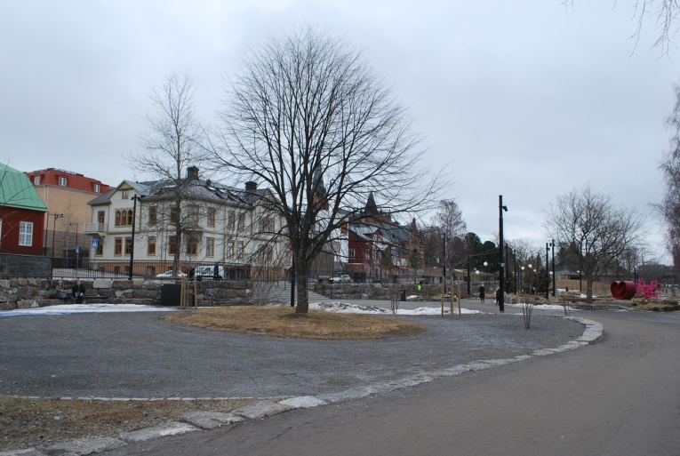
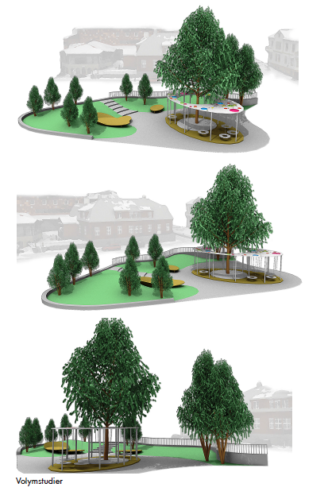
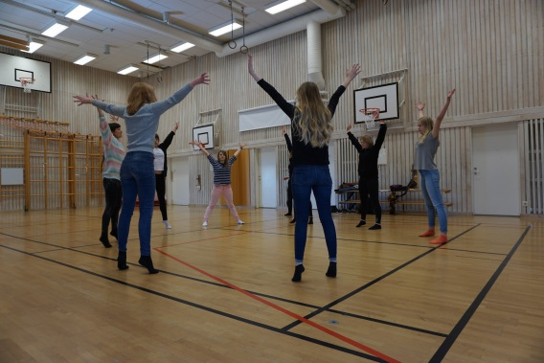
Creating a space free from expectations
  Inclusion through exclusion
  Girls between 15-20 years old
  Influence, dialogue and analysis
  Involvement from Umeå University
  Dialogue and design
Notes:
Part of central park of Umeå in the very city centre, very close to the river.
Creating spaces for everyone. The municipality is a public organisation, the investments are done with public money and the we need to make sure that all inhabitants are heard and that there are spaces or everyone. The head of projects at the parks dep. always says that everyone living in Umeå should have a favourite place in the public space. That means creating different types of spaces.
This project started from the fact that young girls are an underrepresented group in public spaces dedicated to spontaneous sports and activities. They are also underrepresented in dialogues around urban development projects in public spaces.
Therefore, in this project, the dialogue was held specifically, and exclusively, with young girls (“inclusion through exclusion”)
The dialogue focused on how they perceive public spaces, and on expectations, entitlement, safety and of taking and giving space.
The dialogues were dynamic and non-traditional, for example through dance workshops (SE BILDEN)
We tend to create spaces for young people that encourage physical activity but working with these young girls, they wanted a place where they could hang out, and be free from expectations and observation. They talked a lot about the very dual expectations of being a young girl
strong/skinny
Good at school/available for your friends, partner
Speak your mind – perceived as being difficult
Another important issue was safety – a place free from fears and insecurities
They also wanted things like
- Listen to music
- Charge phones
- Free wifi

Slide 10
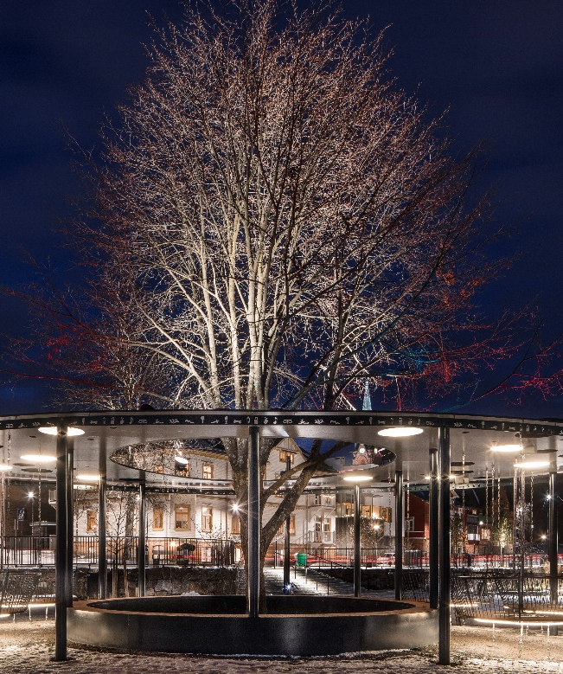
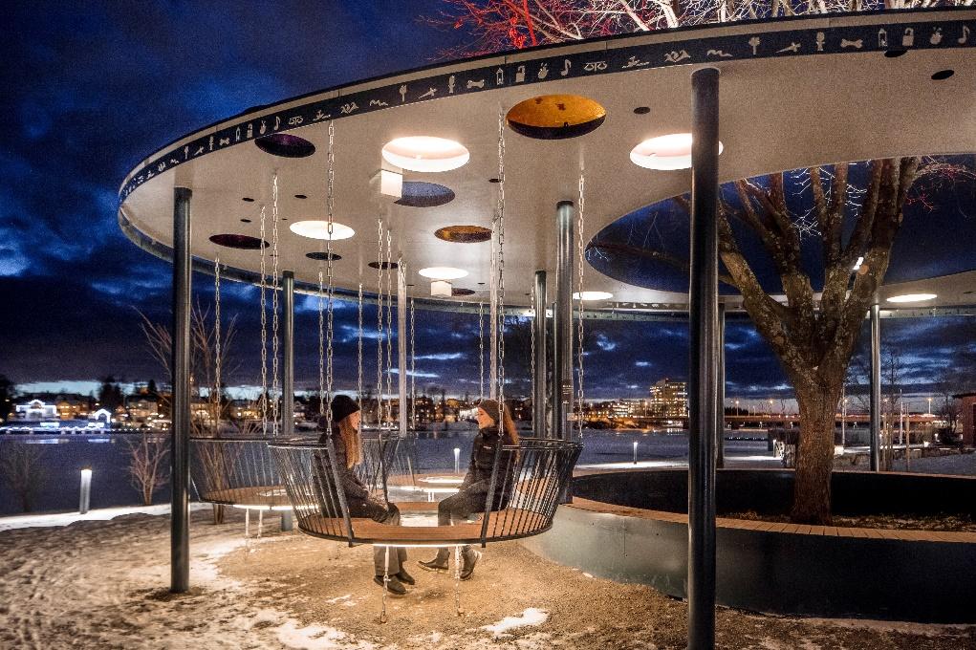
How do we distribute resources?
Fotograf: Andreas Nilsson
Notes:
The final result!
It is called FRIZON (“Free zone”
A place to hang out where everybody will feel welcome
The place is designed with an oval roof with windows in various colours. In the free zone, there are basket seats that were inspired by the gondolas on the 'Whirlwind' roundabout.
Årstidernas Park is a central park in Umeå, where many young people are moving about and passing through. The aim was to create a place that is secure, light and inviting, it has many ways in and out, it is possible to be more and less visible, etc.
There were also wishes for it to be possible to connect the phone and play music from it, which is possible (Bluetooth) – a way of taking ownership over the place.
The pattern around the roof has symbols made by the girls in one of the workshops – a permanent imprint from the girls participation in the physical place.
It is a place for everyone, but the planning has been made against the needs and wishes of the target group. We cannot create environments that are only secure and open to half the population. One simple thing, for example, is to adapt the environment and seating places so they suit girls physically. The height of the back rests is adapted to a person around 1,60 tall, their bodies get to be the norm in this public place.

Slide 11
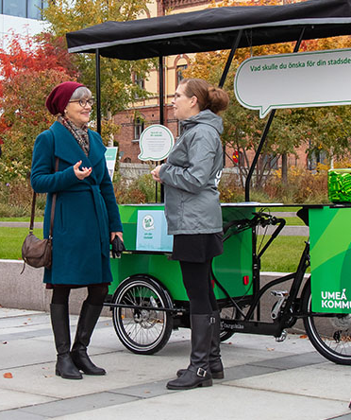
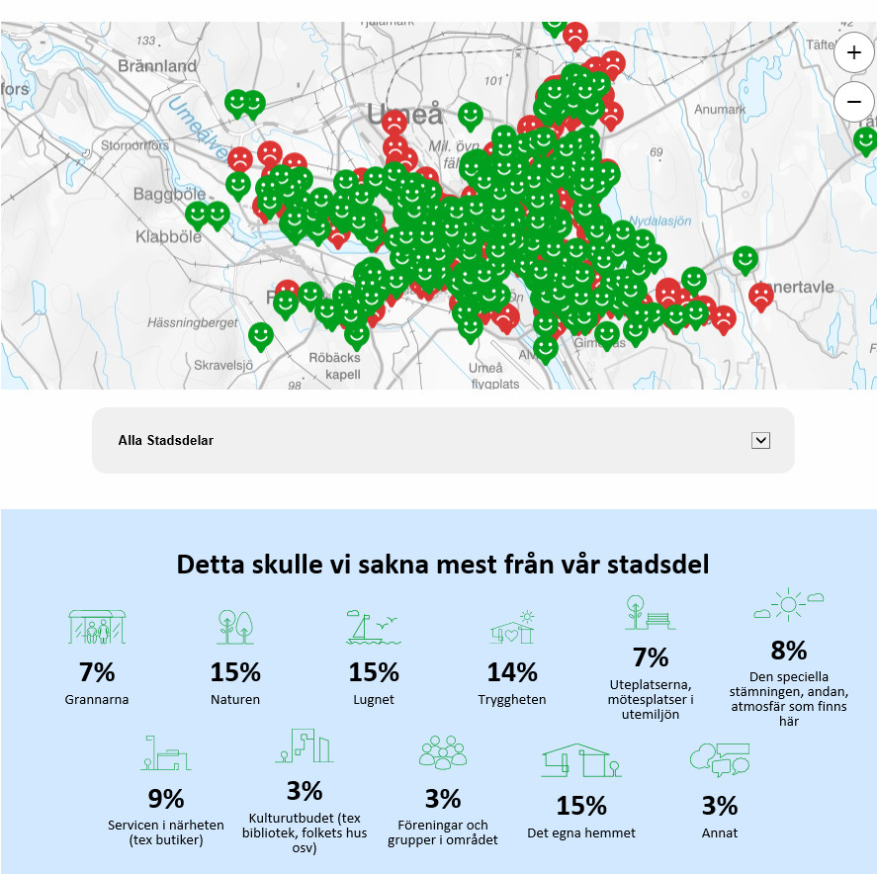
City dialogue – October - December 2019

Slide 12
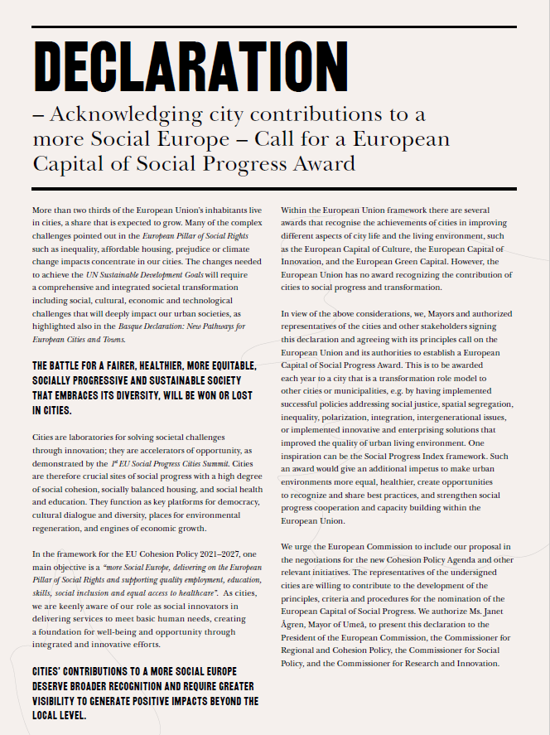
1st Social Progress Cities Summit
16-17th of September, Umeå
Bilbao, Bratislava, Gdansk,
Groningen, Ljubljana, Leuven,
Mariehamn, Umeå
DG Regio, DG RTD
” Cities and nations must work together. National policies alone are spatially blind without the good examples already in place in the cities”
- 7th OECD Round Table of Mayors and Ministers, Athens march 2019

Slide 13
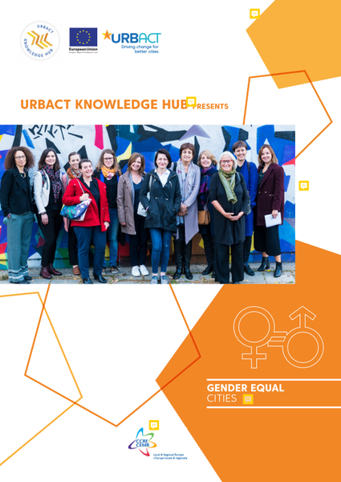
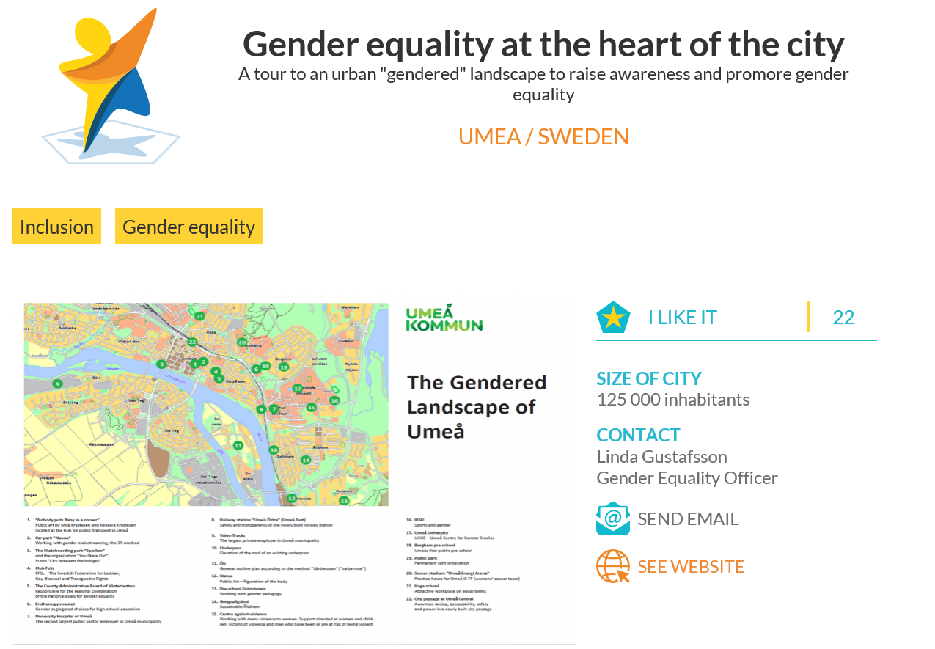
The gendered landscape
Integrating gender equality into urban planning
#genderequalcities
Leading the work with six european cities to create action for gender equality (urbact API)
”Globally understood, locally contextualized”

Slide 14
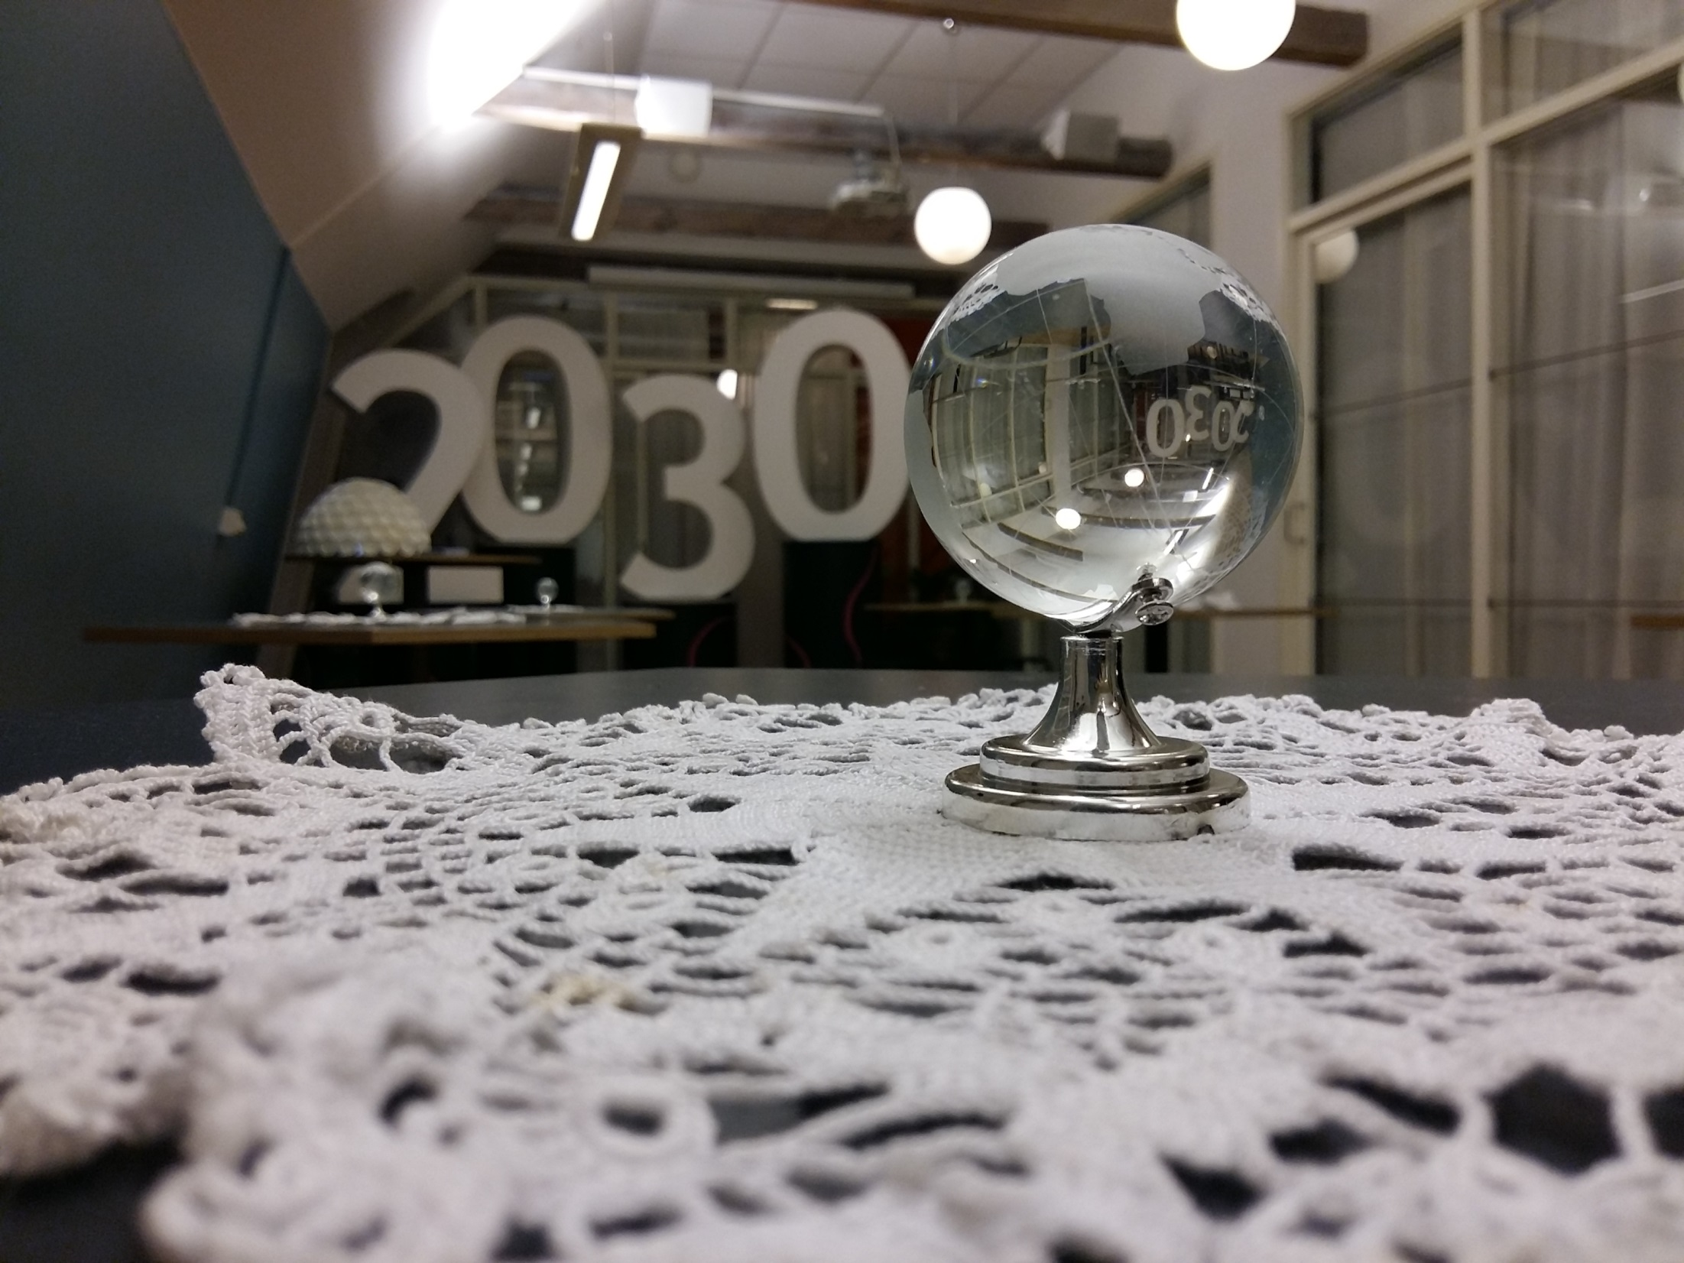

Slide 15

FENOMENALEN
Science Center på Gotland
www.gotland.se/fenomenalen
https://earth.google.com/web/@0,7.658201,0a,22251752d,35y,0h,0t,0r/data=CgAoAQ
Notes:
Omsättning 3 miljoner, 4254 elever i pedagogiska program, 275 grupper. 2, 5 anställda

Slide 16
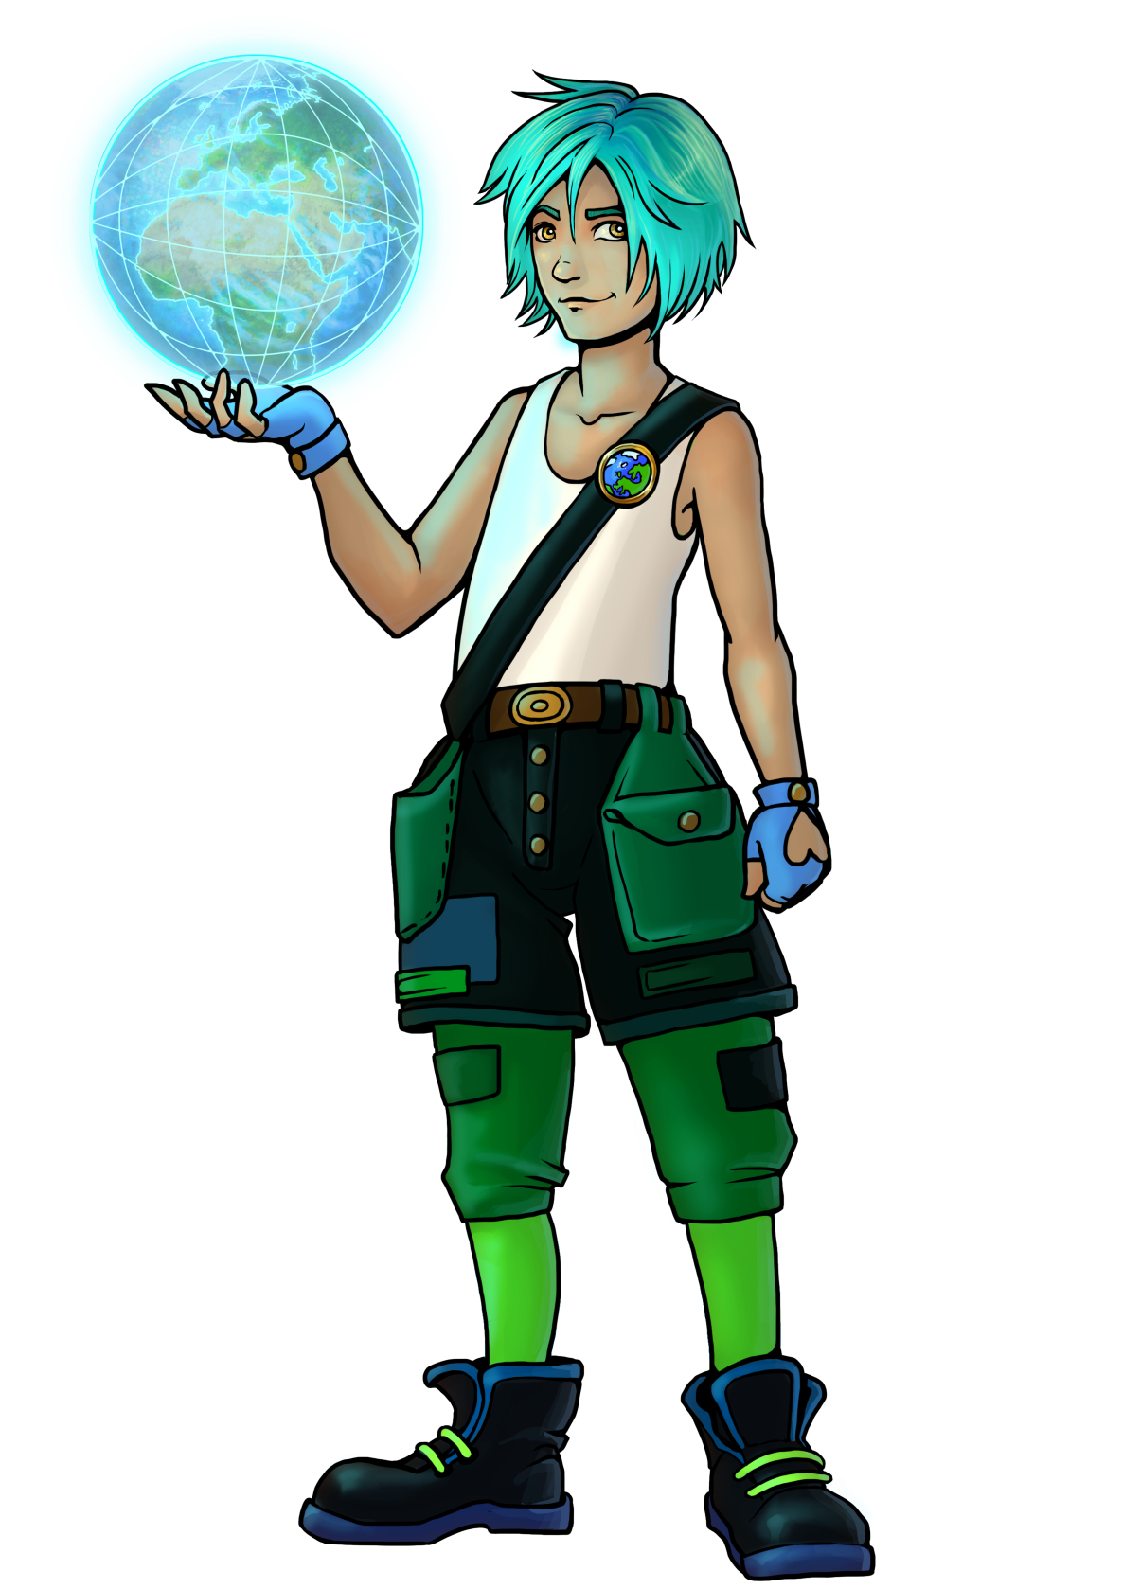
Planetskötare
Guardian
of
the planet

Slide 17
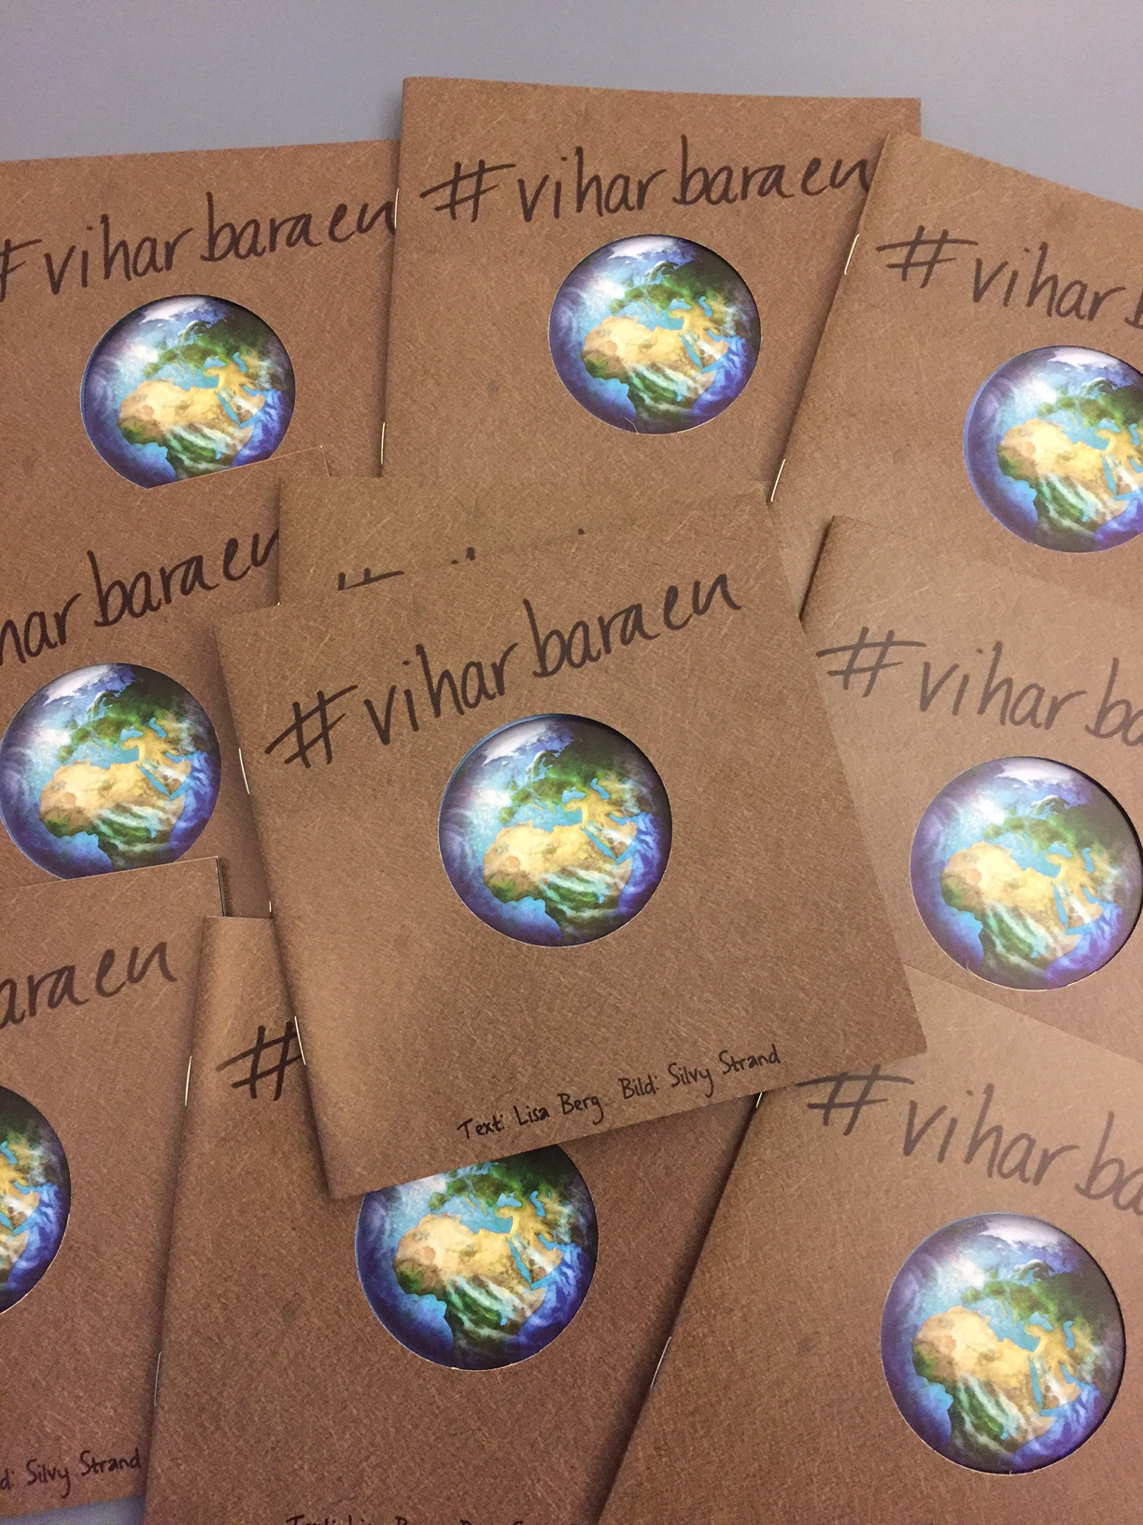

Slide 18
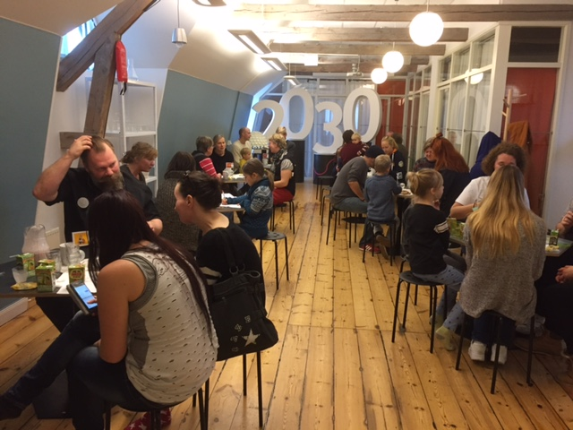

Slide 19
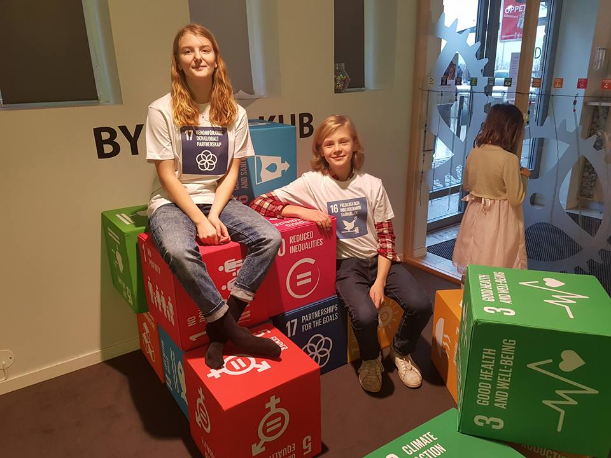

Slide 20
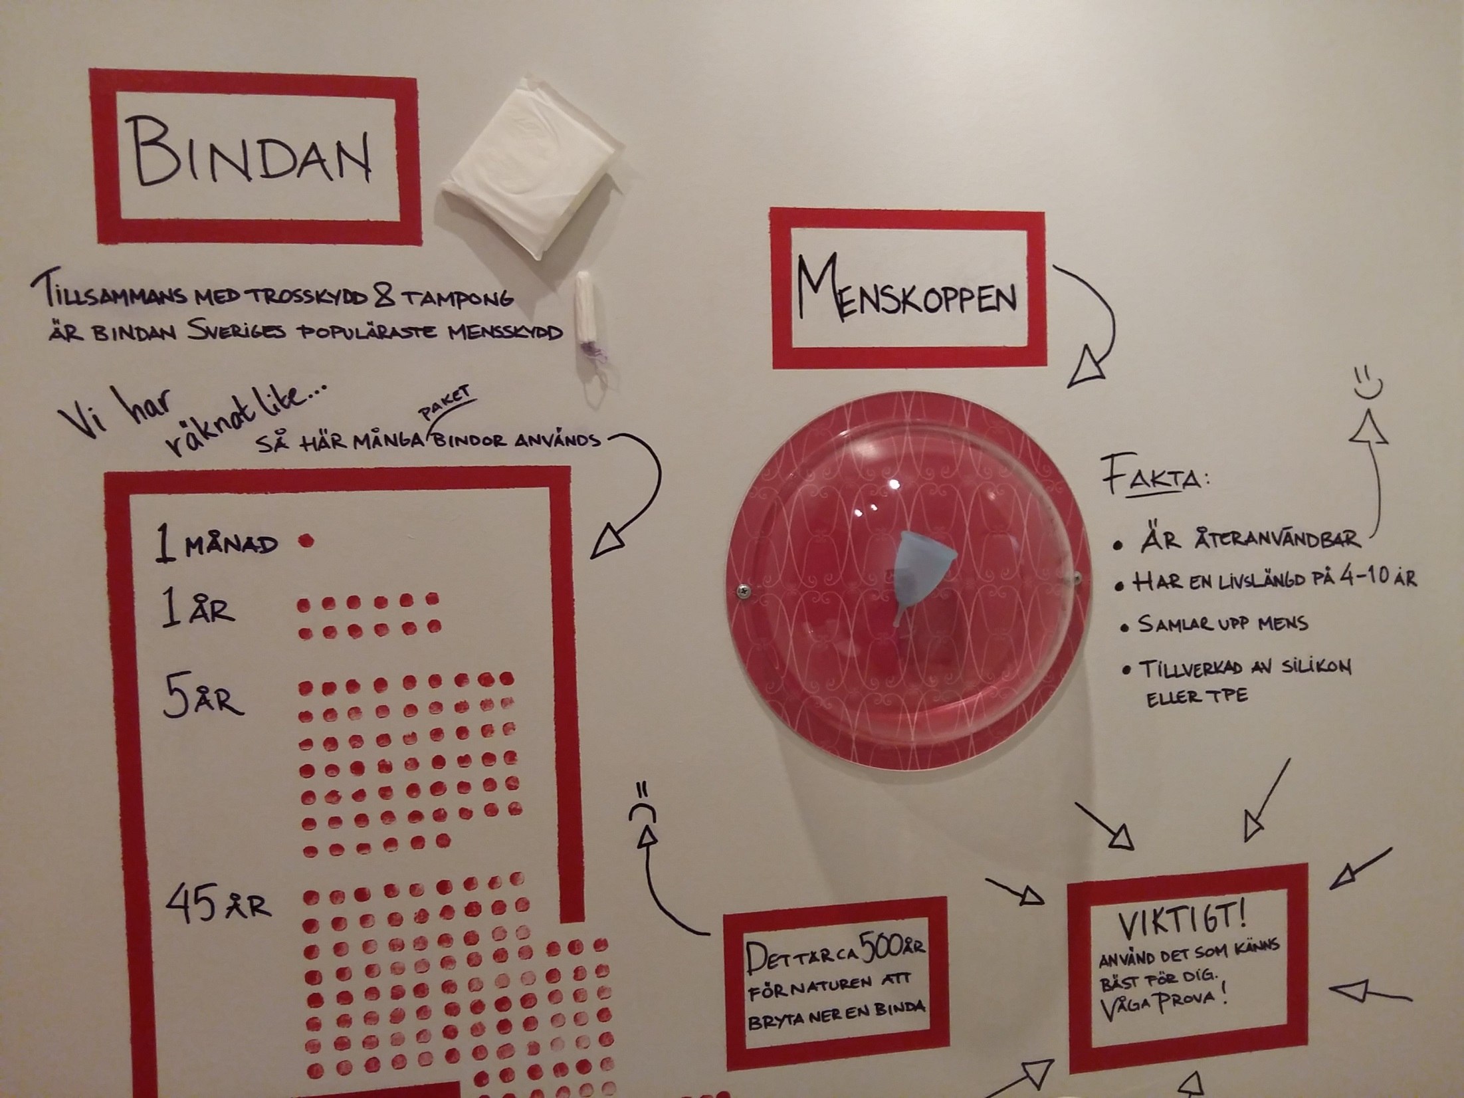

Slide 21
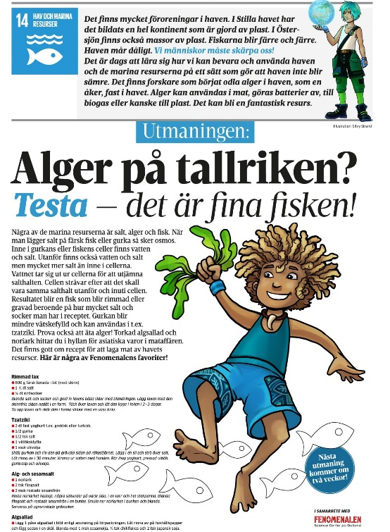
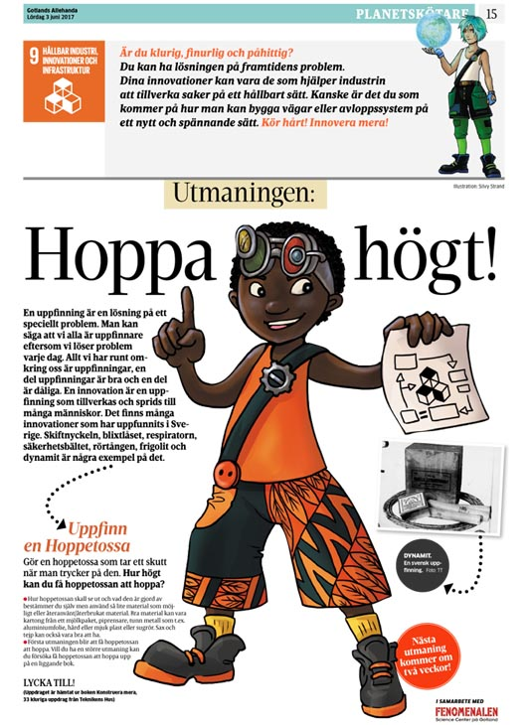
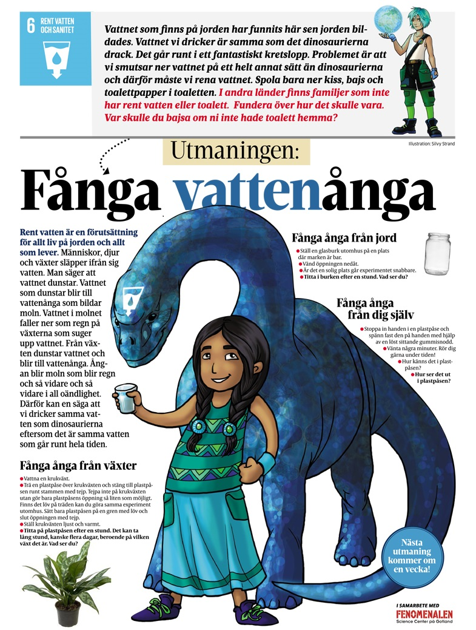
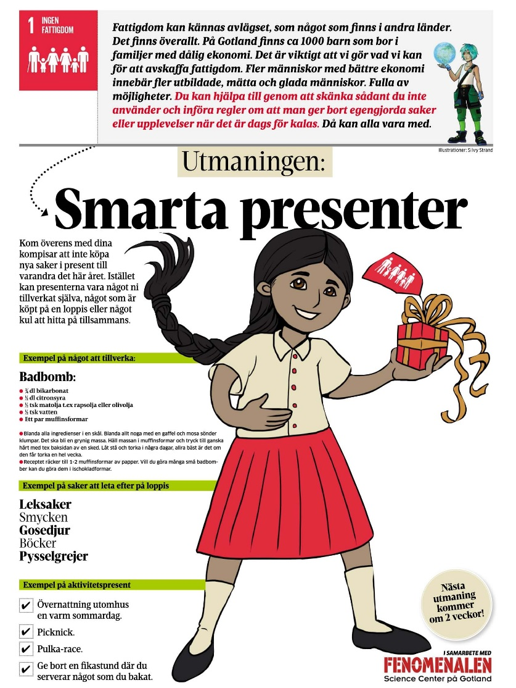

Slide 22
www.tomtit.se

Slide 23
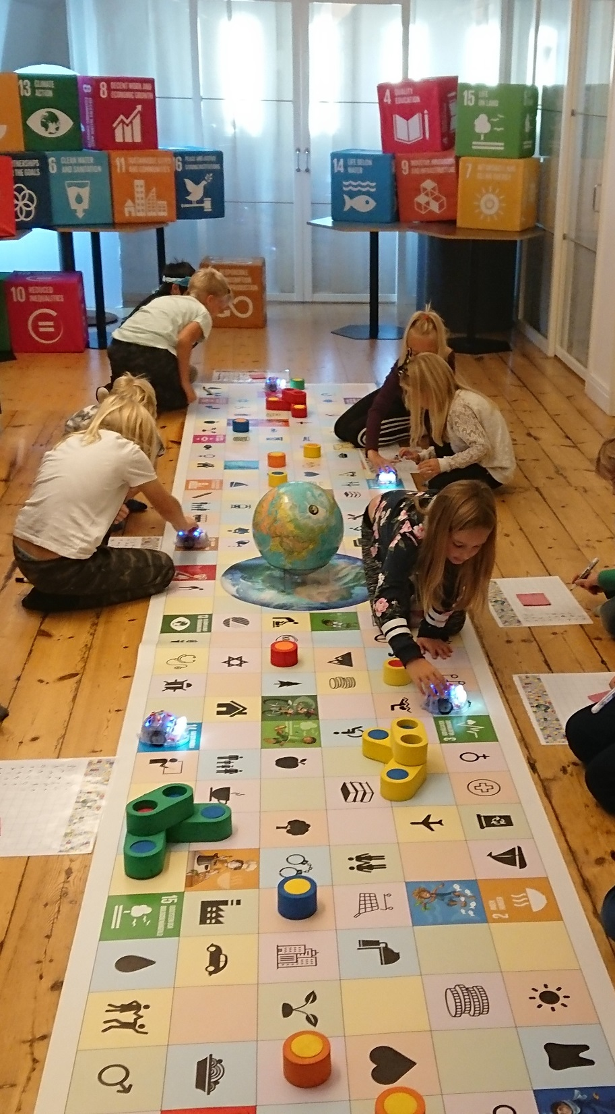

Slide 24


Slide 26
